Slide 1
What is crowdfunding? Sarah McCue Community Funding Officer Lancashire County Council
Notes:
Introduction to the team
Intro Olivia – ask Sarah to introduce herself
We are the two colleagues working on this – may have heard from us, but hopefully everyone has the invitation to the Launch of the Crowdfund Lancashire and by extension the Lancashire Culture and Sport Fund – 1st December 12pm – if you haven't there is a sign up link at the end of this presentation that will take you to register and we can send this out after to everyone on this call

Slide 2
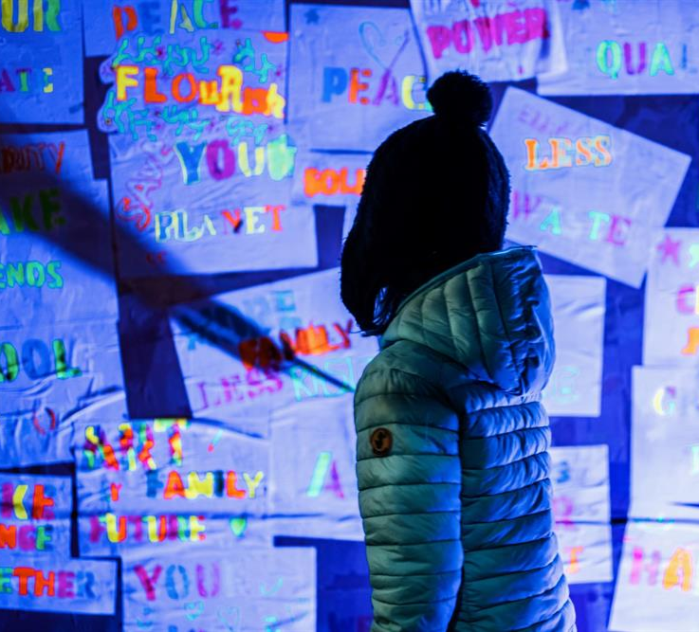
Crowdfunding
The practice of obtaining needed funding by soliciting contributions from a large number of people, especially from the online community
Platforms
Personal - GoFundMe, JustGiving etc.
Business - Kickstarter, Indiegogo etc.
Notes:
So, what is the Lancashire Culture and Sport Fund – read lines on the screen
You may be unfamiliar with civic/community crowdfunding, but you’ve probably all seen a just giving/gofundme campaign before. This is similar – you can raise money for your project through lots of individual online and offline pledges of as little as £2.
- an annual fund of £500,000 split into two rounds per year

Slide 3
Civic Crowdfunding
Started by Spacehive in 2012 to allow communities to make the changes they want to see in their neighbourhoods
Benefits
Gives more autonomy to the community
Projects are well supported before they begin
Share the fundraising responsibility

Slide 4
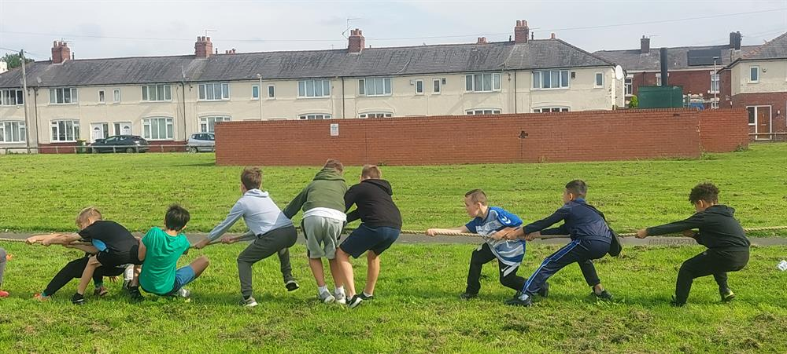
Additional funding
Civic crowdfunding platforms bring in partners to make large donations to campaigns
27 Local Authorities have distributed funds through Spacehive, including Lancashire County Council
Easy way for funders to find projects that fit their aims

Slide 5
Crowdfund Lancashire
Home of LCC’s annual £500,000 Lancashire Culture & Sport Fund
So far, 4237 backers have donated £1,472,898 across 88 successful projects
48 more currently fundraising
96% success rate for projects that receive a LCSF pledge

Slide 6
Who is it for?
Anyone delivering not-for-profit projects that improve the cultural experience and/or health and wellbeing of their community
Constituted groups and not-for-profit organisations can apply for a maximum pledge of up to £15,000
Parish and town councils can apply for a maximum pledge of up to £5,000
Individuals and businesses delivering a not-for-profit project with public benefit can apply for a maximum pledge of up to £1,500
Notes:
In terms of eligibility,
Organisations: your group must be constituted in some way, have a group bank account (requiring two signatures) and be a not-for-profit organisation designed to deliver benefit to the community (and not designed to create a profit/dividends for shareholders). CICs (Community Interest Companies) and CIO (Community Interest Organisations) are deemed eligible as their activities generate revenue which in turn fund activities that deliver community benefit.
Parish and town councils: This is for constituted parish/town councils running a project for community benefit.
Individuals and businesses: This is for individuals or businesses running a project for community benefit.
will have two rounds for raising money. A round is the time period when campaigns are ‘live’ and actively seeking pledges. Each round will be up to 3 months. Applicants may have no more than 1 ‘live’ project in each round. Each round will have approximately £250,000 available to support projects.

Slide 7
How does it work?
Develop your idea​
Attend a workshop​
Check permissions are in place​
Create project page on Spacehive​
Start crowdfunding! Tell everyone!
Project is considered by LCSF
Eligible projects will receive a pledge from LCSF
Meet the target and run the project!
Notes:
Develop an idea: projects that will enhance and support the culture and or sport offer in your local community and be for public and community benefit.
Attend a workshop: Spacehive are hosting two workshops – first 14th December and the second is 12th January. This will give an insight into creating a project page (I'll talk more about that in a minute)
Check any necessary permissions – for example, any road closure permits that might be needed, any planning permission that might need to take place for any capital asset purchases that the project is crowdfunding
Create a project page on Spacehive – once this is done and verified by spacehive
Start crowdfunding – tell everyone! Although this is a online platform there is still the opportunity for off line pledges and fundraising; for example if a project knows that a bake sale works for their local community to raise funds, these funds can be added as a pledge to the online project page
The Lancashire Culture and Sport Fund will consider your project; don't worry, all eligibility is checked before the project page goes live and crowdfunding starts
Meet your target and run your project – we anticipate with the first round the projects will start to deliver in Spring 2023

Slide 8
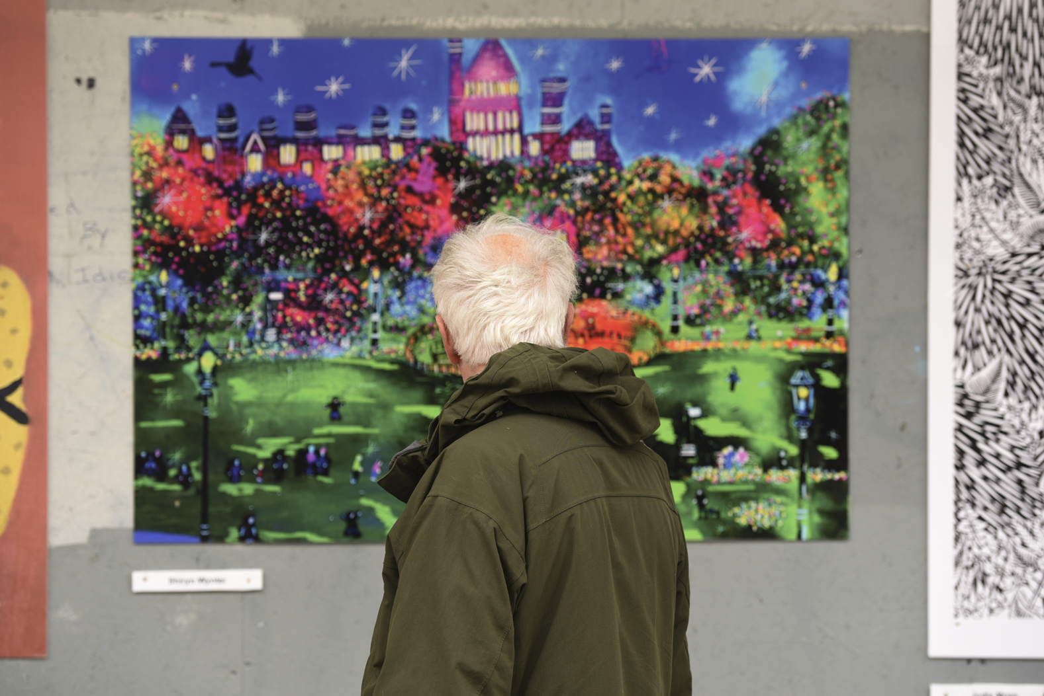
What next?
We are in the middle of a funding round currently
Have a look at the Crowdfund Lancashire page
Talk to me to be added to our contact list
Next funding round will open in June with LCSF pledges distributed in September

Slide 9
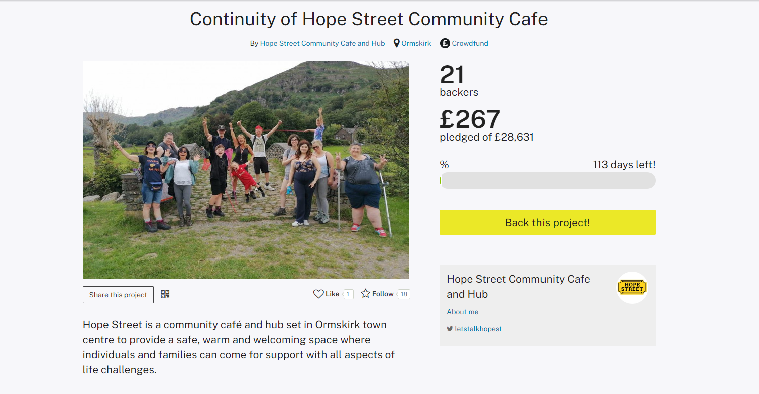
What next?
Support your local projects
Continuity of Hope Street Community Cafe (spacehive.com)

Slide 10
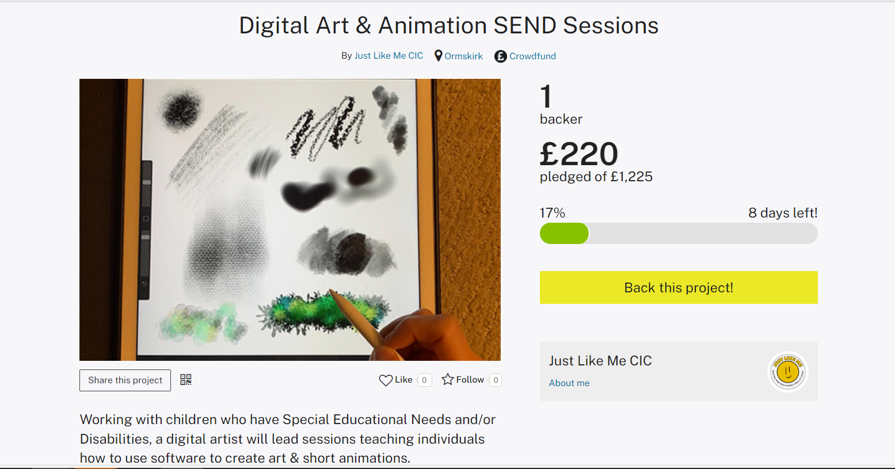
What next?
Support your local projects
Digital Art & Animation SEND Sessions (spacehive.com)

Slide 11
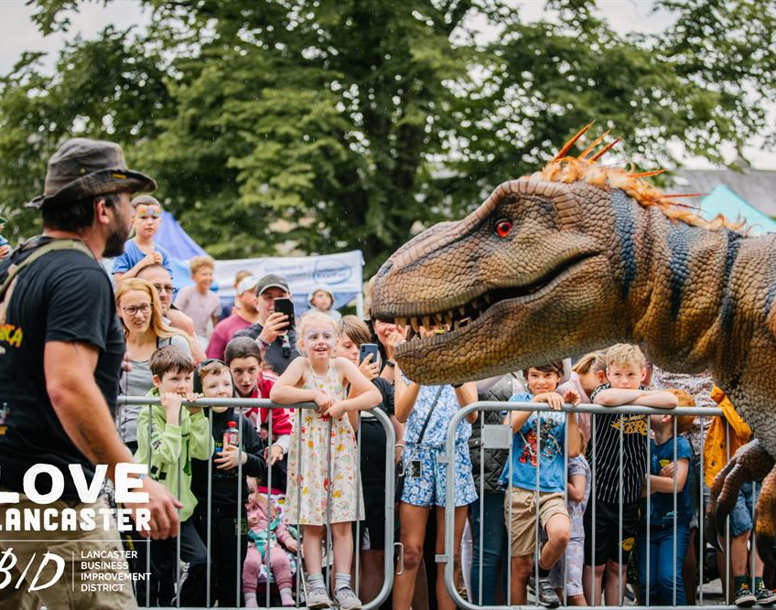
Contact us
Email LCSF: lcsf@lancashire.gov.uk
Email Spacehive: support@spacehive.com
Find out more: www.spacehive.com/movement/lancashire

