Slide 1
The National Lottery Community Fund
West Lancashire CVS Funding & Network Evnt
14th March 2024

Slide 2

About the National Lottery Community Fund
We’re the largest single source of funding for community activities in the UK.
National Lottery players contribute around £30 million to good causes every week.
The National Lottery Community Fund distributes around £600m a year to communities across the UK

Slide 3

What is monitoring and evaluation and why is it important?

Slide 4

What is monitoring and evaluation?
Evaluation is about gathering evidence to measure the value and quality of your project.
Evaluation involves more than just describing what happened. It’s a way of collecting evidence and analysing it so that you can demonstrate to others whether your project met or exceeded your expectations.
The best evaluation sets out to be as honest as possible. Showing that you recognise mistakes and can learn from them, is a good quality.

Slide 5
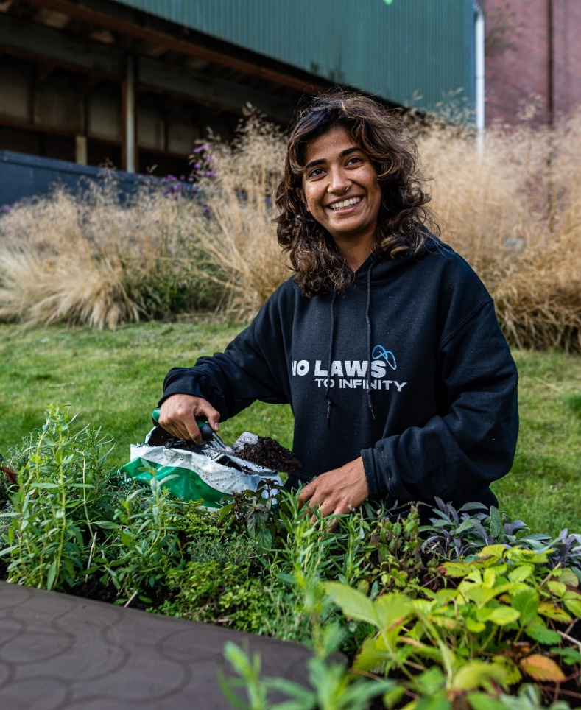
Why is it important?
Evaluation is important for three main reasons. It will help make sure that you are:
1) doing your best for those taking part
2) using the resources you have in a responsible way
3) learning from the process, in ways that improve, develop and sustain the work you are doing

Slide 6

How can you use monitoring and evaluation to support your work?
Monitoring and evaluation can helpful for your organisation to:
identify what's working well and why
identify and act on things you'd like to do better
share experiences, practical tips and ideas with others
show what has been learned by staff and volunteers
ask others for help and feedback to tackle challenges
help change and challenge public attitudes and influence public policy
reduce duplication
show funders and decision-makers how your work makes a difference e.g to individuals, group and the wider community
Shantona
Notes:
We encourage all grantholders to gather and share learning and insights from their work. But we don’t tell you how to do this, because there’s no right or wrong way. The focus should be on what’s useful for you.

Slide 7
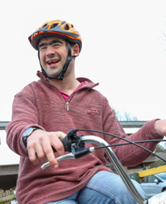
Before you start
Decide what you want to learn about
Decide how you’re going to collect and analyse your evidence
Involve other people in your learning
Think about quantifiable targets or time-based targets
Think about outcomes and objectives
Consider resources available
Decide whether you want to involve an external evaluator
Notes:
Start by deciding on some areas you want to learn about so it’s manageable. You can’t tackle everything at once.
Think about:
• Why are you doing this project?
• What specific things do you want to achieve?
• How will you know whether or not you have succeeded?
Targets
Think about how many people you want to work with as part of this project. Who will directly benefit? Who might indirectly benefit? How do you capture this? What outcomes do you expect to see and over what time-period would you like to see the difference being made? Think about whether your targets are realistic – you can look at your own previous history delivering the work, or if its something new to you, you could look at the work of others to get a sense of best practice.
Collecting evidence
• Who will be involved in giving and collecting the evidence? –
• How will you collect the evidence you need?
• What methods of collecting evidence will best suit the way you work?
• When – in the lifetime of the project – will you use these methods?
You need to make sure that you choose systems that are appropriate to the size of your project and the resources you have available.
Involving others
Once you’ve figured out what learning you’ll focus on, you should think about who should be involved. It’s up to you to decide who is best to involve in your evaluation, but it could include:
staff
volunteers
Service users
people from your community
your project partners
other organisations doing similar work
commissioners
funders
your local authority
You should always talk to the people involved in your project to help you decide what learning to focus on.
Project participants have a lot to contribute and involving them in evaluation can give them a sense of ownership. Project participants are often the best people to highlight important issues about work of the project to professionals. Some can act as representatives in meetings with staff in evaluation processes and may partake in project steering groups, where you can bring people together to discuss ideas and issues, share knowledge, and build understanding within and between communities.
External evaluation - in order to gather independent advice and constructive criticism you may want to call on the advice of an external evaluator. You’ll still need to work out your aims, objectives and outcomes, and set milestones and time-scales.

Slide 8
Putting together a monitoring report
When putting together your report, you should be reflecting on the aims of your project – what did you set out to do and how well did you achieve that.
We like to know:
Have you delivered the activities as planned?
What’s worked well? What have been the challenges?
How have you involved your community?
What difference has the funding made?
How do you plan to share and use what you’ve learned to plan for the future?
Have you spent your budget as planned?
Notes:
It can be useful to include details such as:
• the number of people involved in the project as participants;
• the work of the project – the activities delivered; - It’s okay to change things. And if they have it’d be good to know why.
• constraints - areas where the project has faced obstacles or barriers;
• problems encountered and how you have dealt with them;
• Community involvement, - If we recognise that people can identify their own needs, in what ways can you empower them to take the reigns on these issues. Are you doing something really well or unusual to involve the community?
• the views of the participants – looking at what they have learned or liked about the project; how the project has helped them individually, within their families or community and the wider society;
• the views of partners and agencies who have a special interest in the project;
• good practice – what has worked well? Whether things have or haven’t gone well, we like to know if you’re using this learning to help yourselves or other organisations.
• impact – how your project has made a difference; How you’re progressing toward the original goals of the project. What evidence you have to show they’ve made a difference. You can think about impact not only in terms of the benefits to individual service users but also to groups and wider communities;
• Unexpected consequences;
• Evidence of value for money – Numbers of beneficiaries, social value gains etc
Spend – If not spent as planned, it would be good to find out why.

Slide 9

Questions?
Notes:
If you need support with your monitoring and evaluation, you can speak with West Lancs CVS for advice.

