Slide 1
Simply Well Simply be a friend
Isolation exacerbates any mental health problem. If you are anxious or depressed, feeling isolated will make it worse

Slide 2
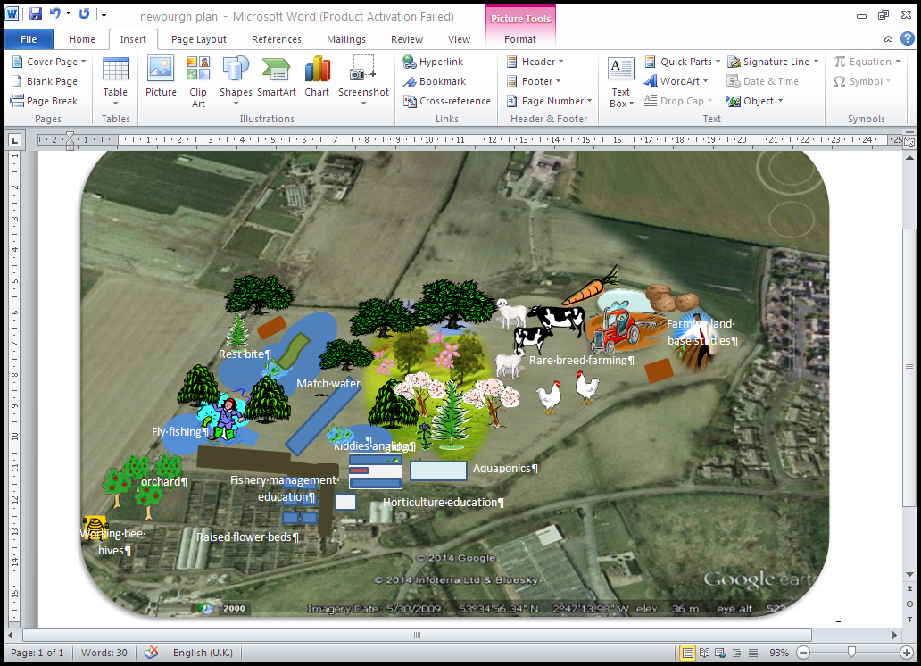
The aim of the program was to bring our senior citizen together to enjoy activities and make new friends
We complete activities around
Meet the animals, including Dog show
Fishing sessions
Horticulture
Arts and crafts
Memory Lane

Slide 3
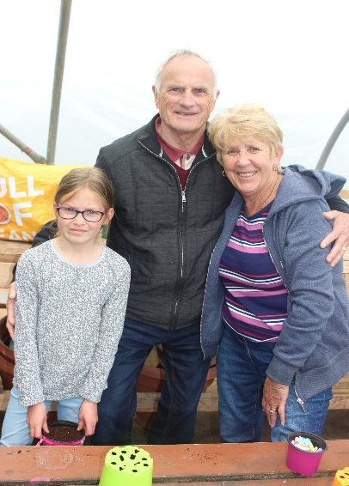
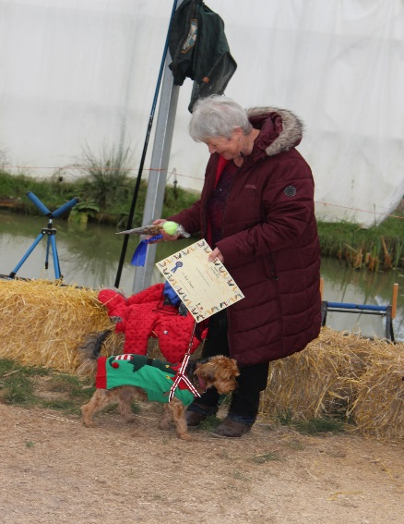
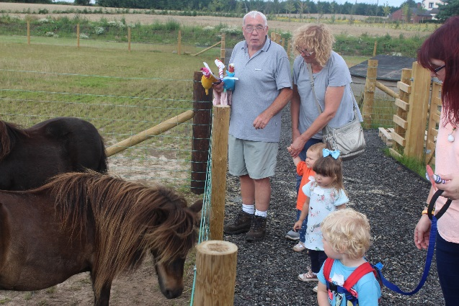
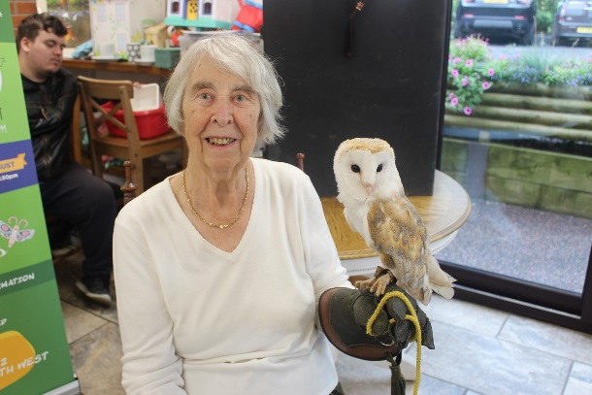
Meet the animals
Within our activities we built in consultation to assess what our referrals wanted to take part in and how we can improve on past activities completed
One main point that was pointed out the grand parents have grand children through summer and this would be good to complete together
We took this on board but also ran family days to bring the family in whole together
This helps to improve mental Well being but also allows siblings to understand the emotions and feeling of the grandparents
The work around the grandkids helped to break down intergenerational barriers bringing people closer together.

Slide 4
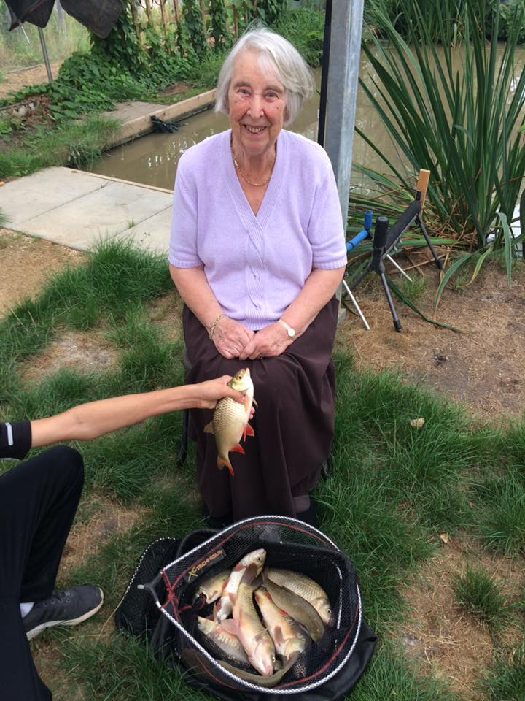
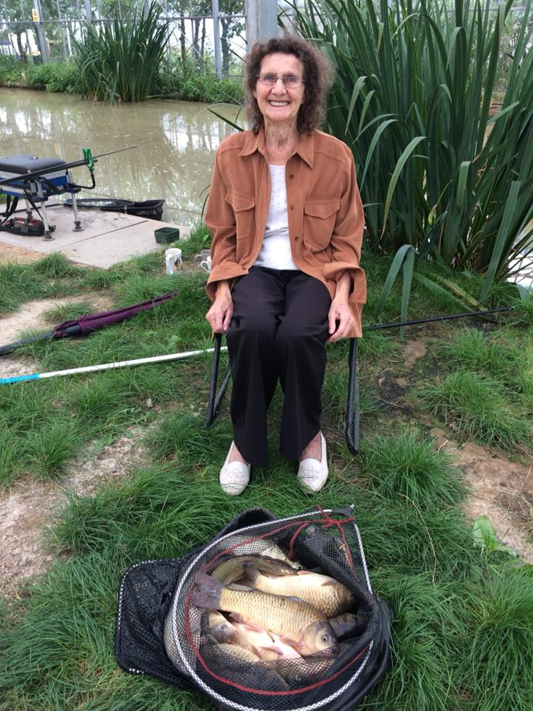
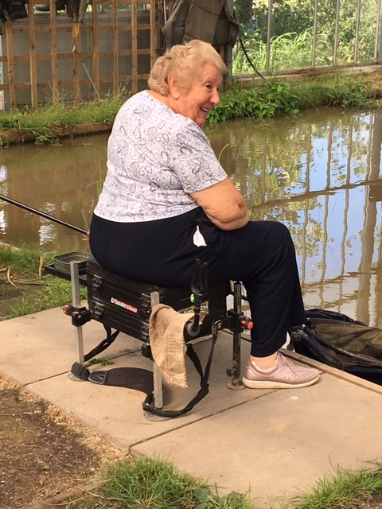
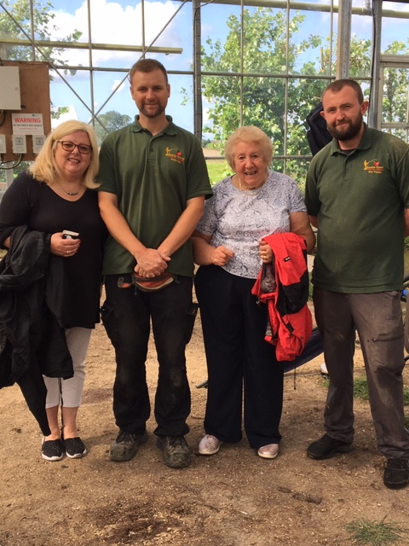
Angling in Age Angling provides a range of physical activity levels and encourages activity amongst the inactive Angling allows for gradual increases in participation frequency, duration and intensity as confidence, fitness and skills develop. Angling encourages therapeutic engagement and contact with ‘blue-green spaces’,

Slide 5
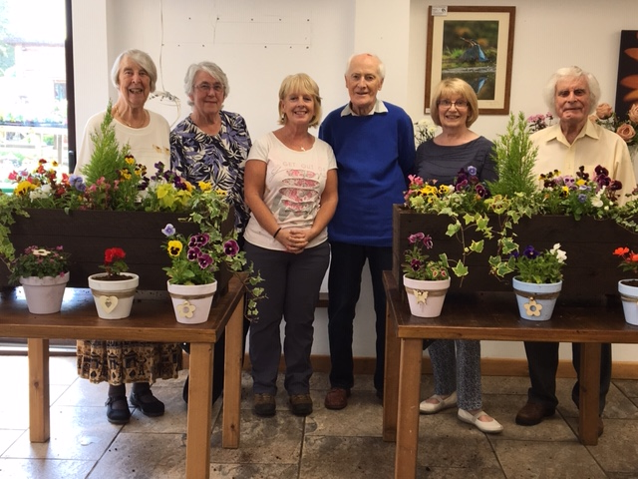
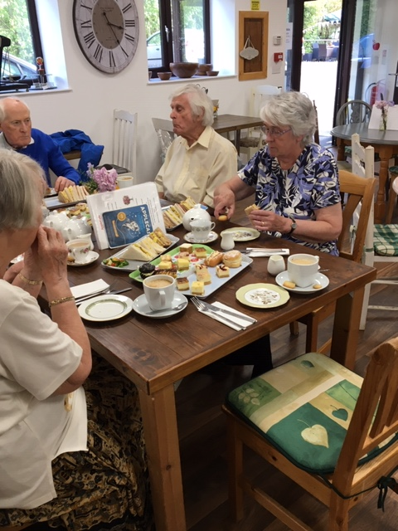
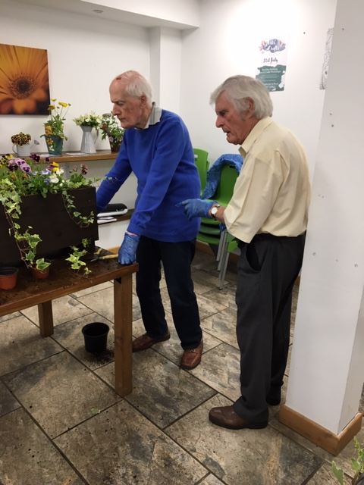
Horticulture at AppleCast
Due to the nature of the weather when completing the horticulture we completed the horticulture in doors.
Gardening can help everyone, regardless of age or disability and can provide a wealth of opportunities for recovery, therapy, recreation and education.
The opportunity to connect with others – reducing feelings of isolation or exclusion

Slide 6
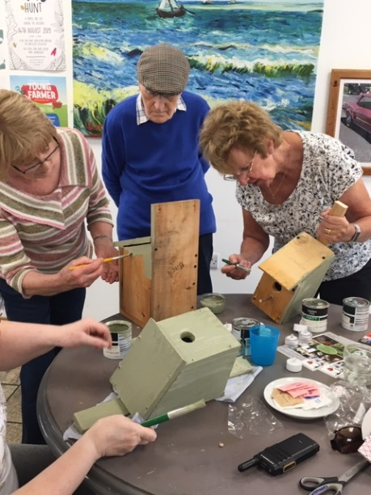
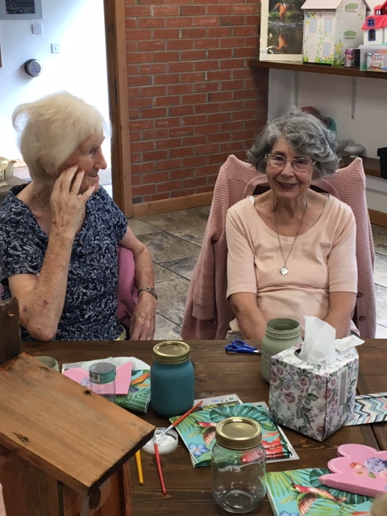
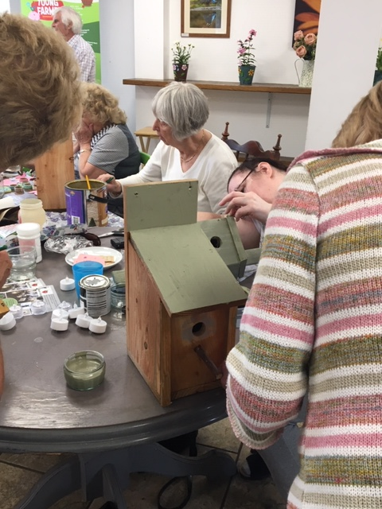
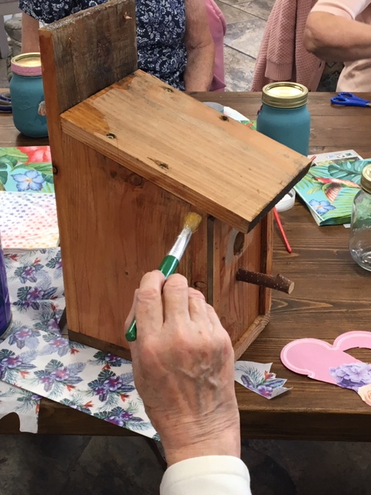
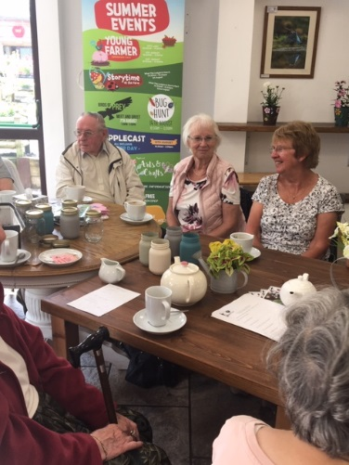
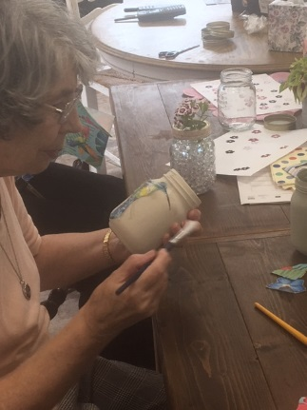
Arts and crafts
Our Arts and crafts went down very well. We aimed the sessions to simulate the brain and be creative.
Creative activities are a remarkably useful for improving health and wellbeing, particularly for those feeling isolated.

Slide 7
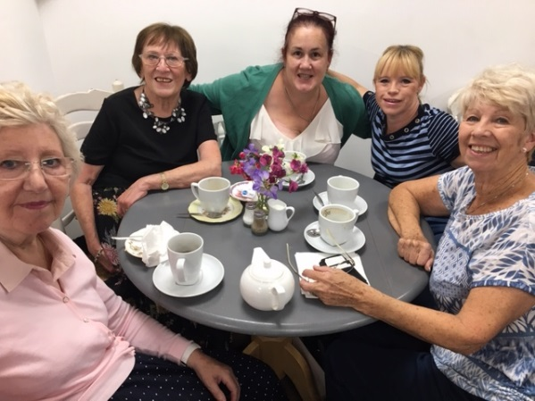
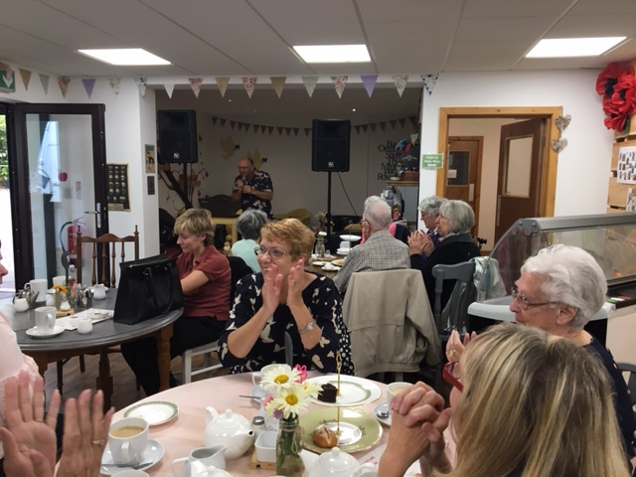
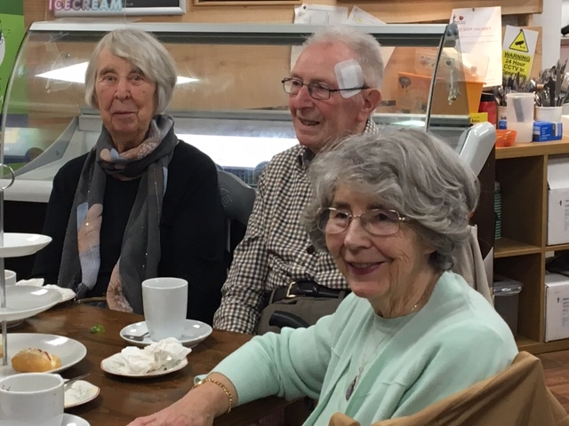
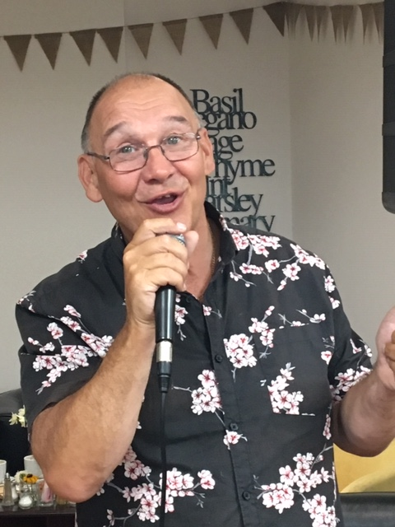
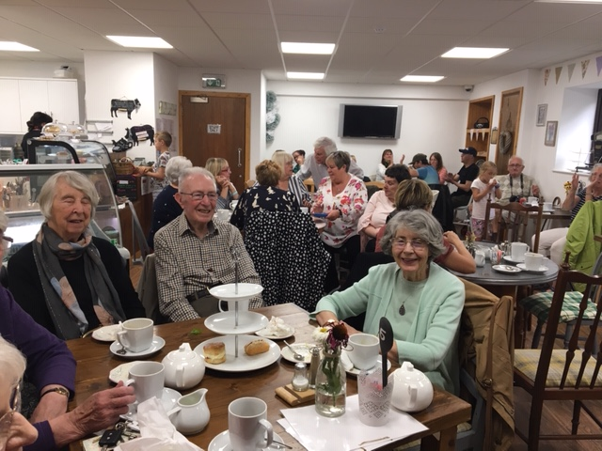
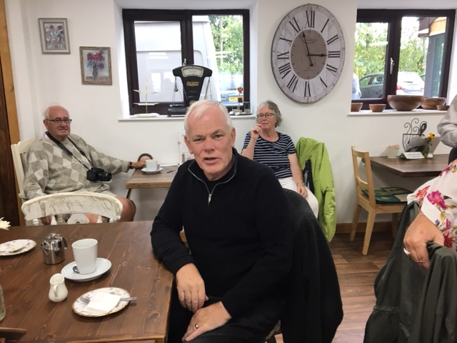
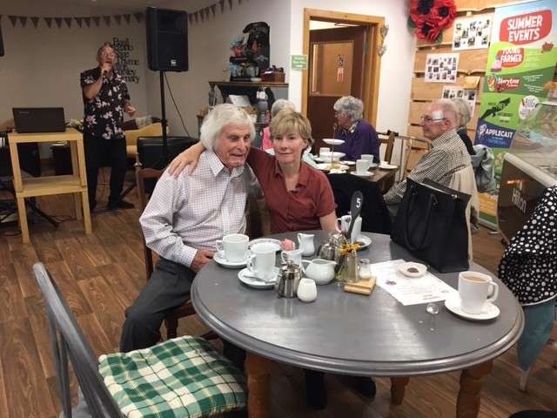
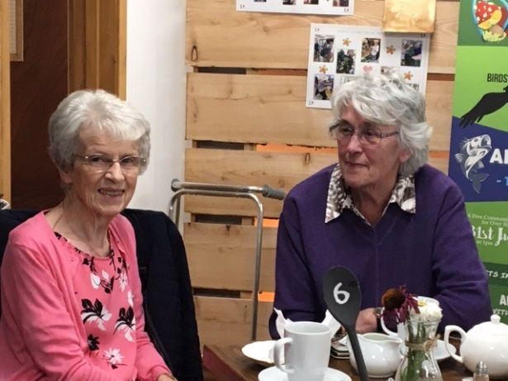
Memory Lane Singing can improve brain activity, well-being, and mood. The memory lane sessions aimed people coming together to have afternoon tea whilst enjoying a sing along and reminisce of old times. The session went really with gentle exercise through out (swinging of arms and swaying) Theses session have become the most asked for coming up to WINTER

Slide 8
What have we discovered through our activities
Its great to meet new people
Have a friendly face
Take time to talk
Encourage healthy life style (small walk)
Inform on other social networks
Maintaining social interaction
Ask for input
I feel let no body does anything , this is great.”
Its nice to know people care
Feedback
“I feel comfortable and relaxed here”
I feel better about myself
Diagnosed with dementia
Really enjoyed being with grandchildren today

Slide 9
Any Questions

