Slide 1
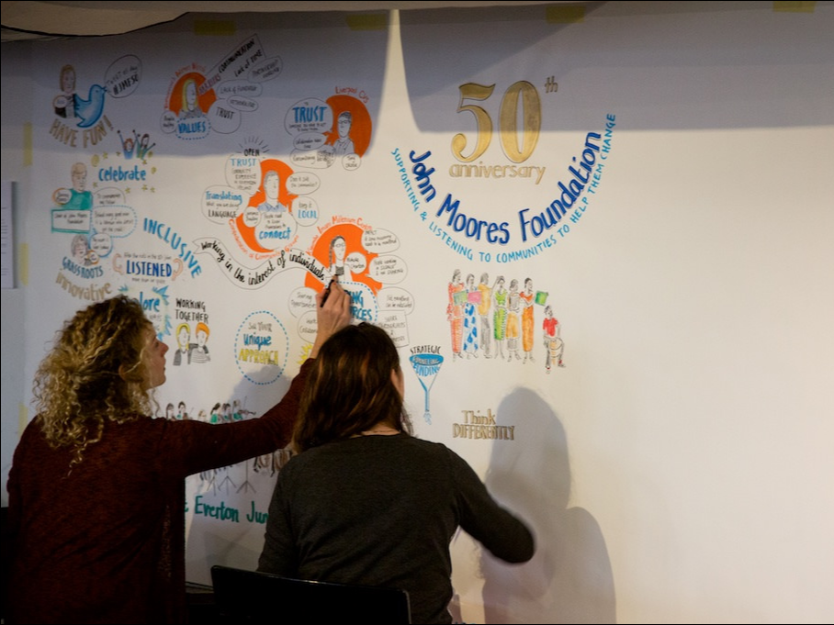
John Moores Foundation
Notes:
IMPACT ACROSS BORDERS: IMPROVING COLLABORATION BETWEEN UK-WIDE, REGIONAL AND DEVOLVED COUNTRY TRUSTS TO ACHIEVE GREATER IMPACT
What are the experiences and benefits of collaboration between trusts who have remits to fund across the UK or in parts of the UK? At this session, a select panel will share intelligence on need, consider the impact of differing contexts and look critically at what works. We will explore both collaboration in funding and in influencing wider change, and whether and how improved collaboration could achieve greater beneficiary outcomes.
Contributions by participants will be actively encouraged, supported by a small panel of contributors and a facilitator.
Will interest: Representatives of trusts with a remit to invest UK-wide, as well as those with a focus on Northern Ireland, Scotland or Wales.
Speakers: Gilly Green, Head of UK Grants, Comic Relief; Phil Godfrey, Grants Director, John Moores Foundation; Fiona Duncan, CEO, Lloyds TSB Foundation for Scotland. Chaired by Maddy Halliday, CEO, Life Changes Trust.

Slide 2
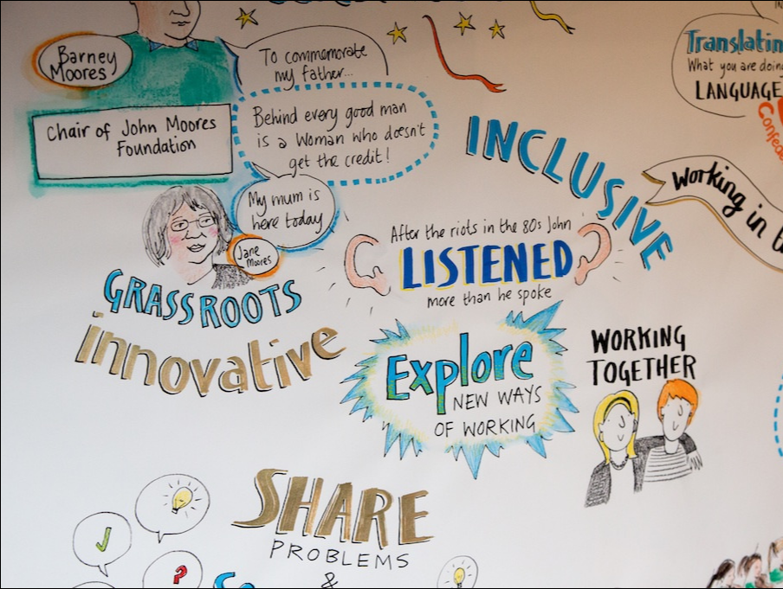
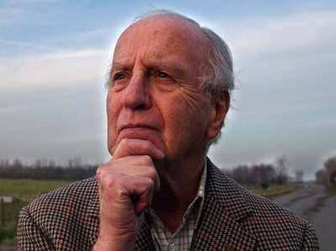
Notes:
Founded in 1964 by John Moores junior.
CBE in 1993 in recognition of his campaigning for the rights of women and people from ethnic minorities in the workplace.
He was also Chancellor of Liverpool John Moores University, named after his father.
Died 2012, aged 83.
“From quite small roots, the Foundation has come to play a significant role in various, social and community initiatives and has helped to establish, and support, a huge number of groups. And over the years it has grown into a well respected organisation, an achievement of which John was particularly proud.”

Slide 3
We have always prided ourselves on our ability to listen, to take on board advice and even criticism
. . . recognising where we made mistakes and learning from those who are actually doing the work.
Notes:
Barney Moores November 2015

Slide 4
Local community groups Black and Minority Ethnic Organisations Refugees Women including girls Children and young people Advice and information to alleviate poverty Grassroots social health initiatives Training for voluntary organisations Joint working and trust building initiatives Equality and Diversity
. . . enable people who face barriers, as a result of social, educational, physical, economic, cultural, geographical or other disadvantage, to improve their social conditions and quality of life.

Slide 5
Local community groups Black and Minority Ethnic Organisations Refugees Women including girls Children and young people Advice and information to alleviate poverty Grassroot social health initiatives Training for voluntary organisations Joint working and trust building initiatives Equality and Diversity
. . . enabling funder and would like to help groups achieve their targets and outcomes in their own way.
Priority is given to small, grass-roots and volunteer driven organisations.

Slide 6
WHAT WE MAKE GRANTS FOR
running costs
salaries
volunteers’ out-of-pocket expenses
one-off projects
equipment

Slide 7
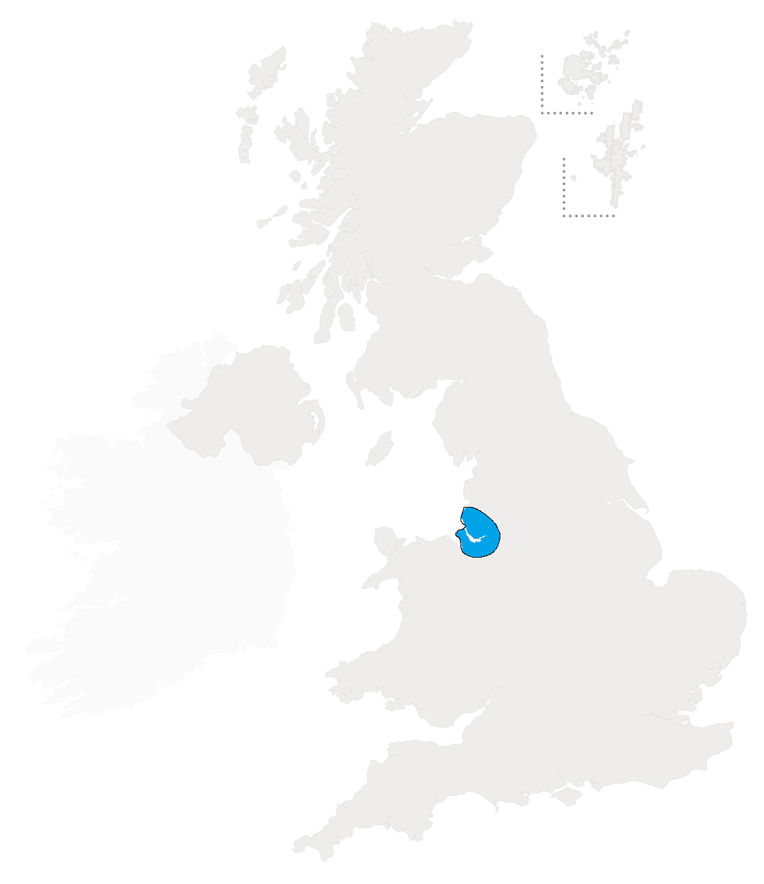
Local community groups Black and Minority Ethnic Organisations Refugees Women including girls Children and young people Advice and information to alleviate poverty Grassroot social health initiatives Training for voluntary organisations Joint working and trust building initiatives Equality and Diversity
Advice and information to alleviate poverty
Black and Minority Ethnic Organisations
Equality and Diversity
Grassroots social health initiatives
Joint working and trust building initiatives
Local community groups
Second chance learning
Training for voluntary organisations
Women including girls
Carers
Children and young people
Family support
Homeless people
Refugees

Slide 8
GENERALLY WE DO NOT FUND
Individuals
Statutory Bodies
Capital building costs
Festivals
The creative industries
Holidays & expeditions
Sport
Vehicles
Animal charities
Uniformed groups
… 14 more items listed on our website and pamphlet

Slide 9
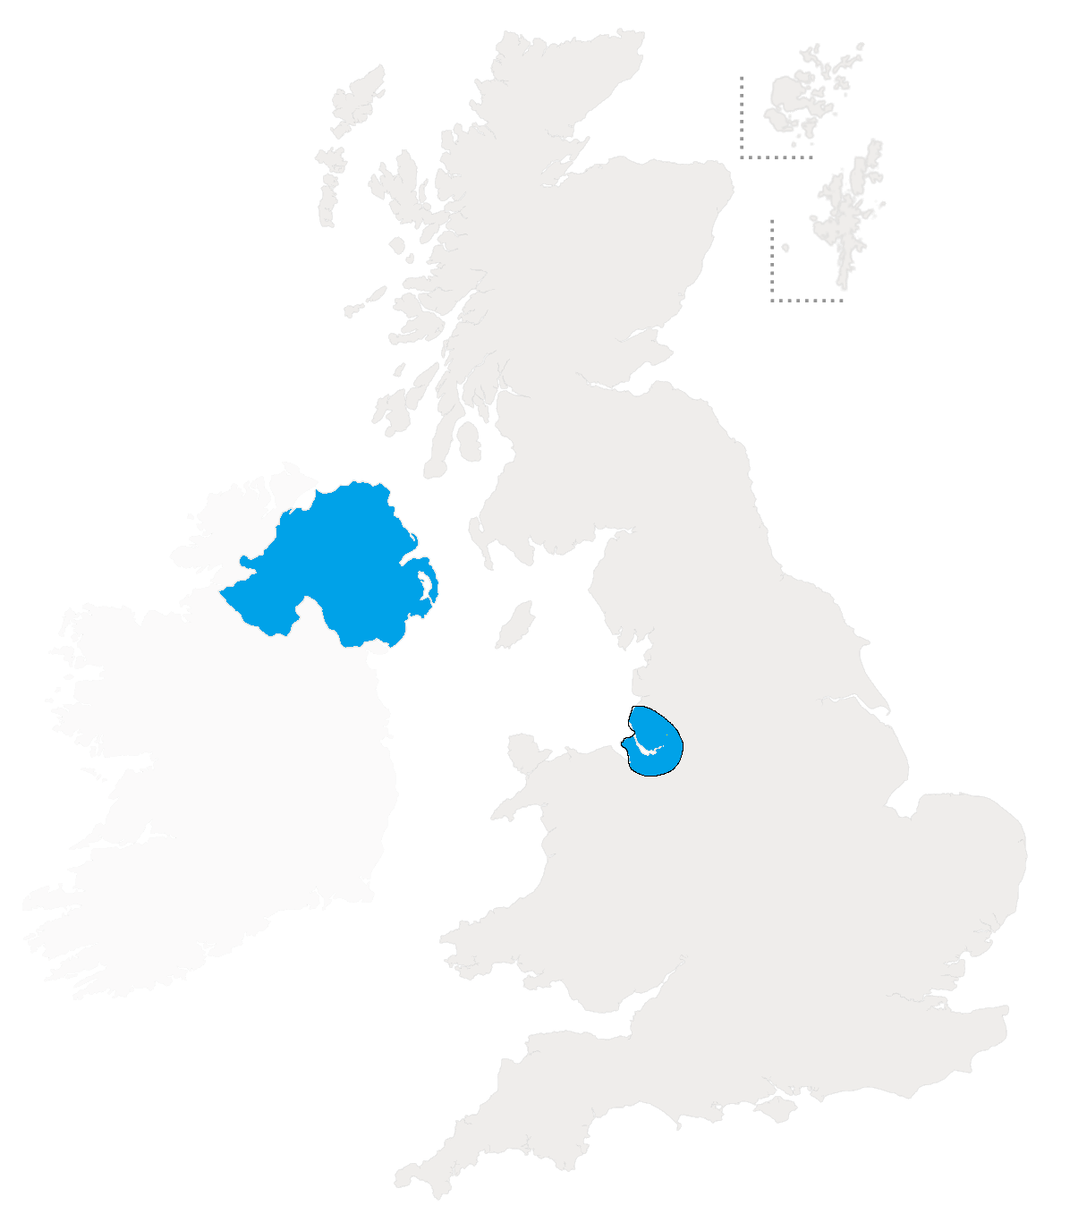
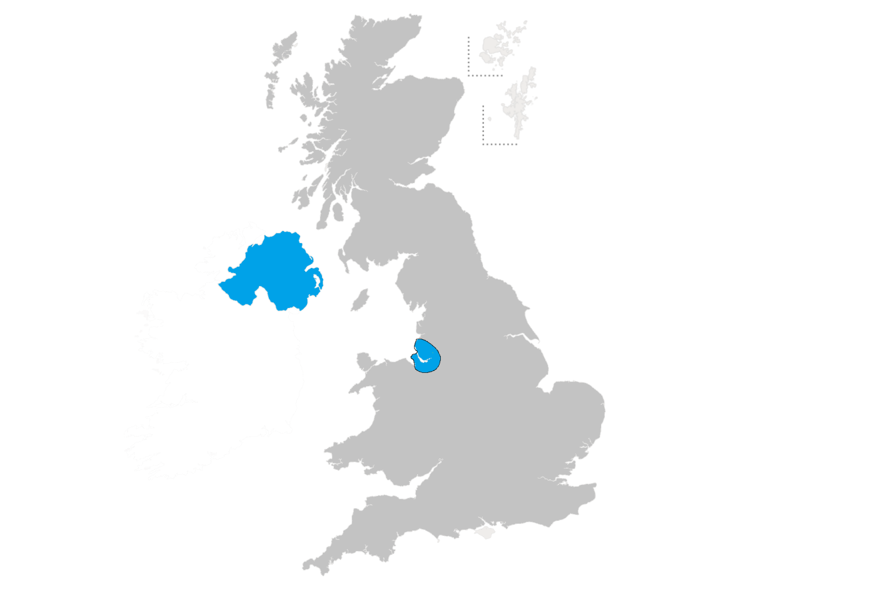
Local community groups Black and Minority Ethnic Organisations Refugees Women including girls Children and young people Advice and information to alleviate poverty Grassroot social health initiatives Training for voluntary organisations Joint working and trust building initiatives Equality and Diversity
Also a grants programme in Northern Ireland
In Merseyside:
About 100 grants per year ≈ £600,000
In Northern Ireland:
About 35 grants per year = £160,000

Slide 10
New developments
Some tightening up of criteria (see booklet)
No deadlines
(you should allow 3 to 5 months from submitting the application to when you need the money)
User survey coming out soon
Recently moved premises

Slide 11
Hints & Tips
Ask for the amount of money you need, not what you think you might get
Ask for something that is already working well and needs to be kept going
If a new project, then it clearly needs to be in response to major changes
Don’t pad out the letter just to make it 4 pages

Slide 12
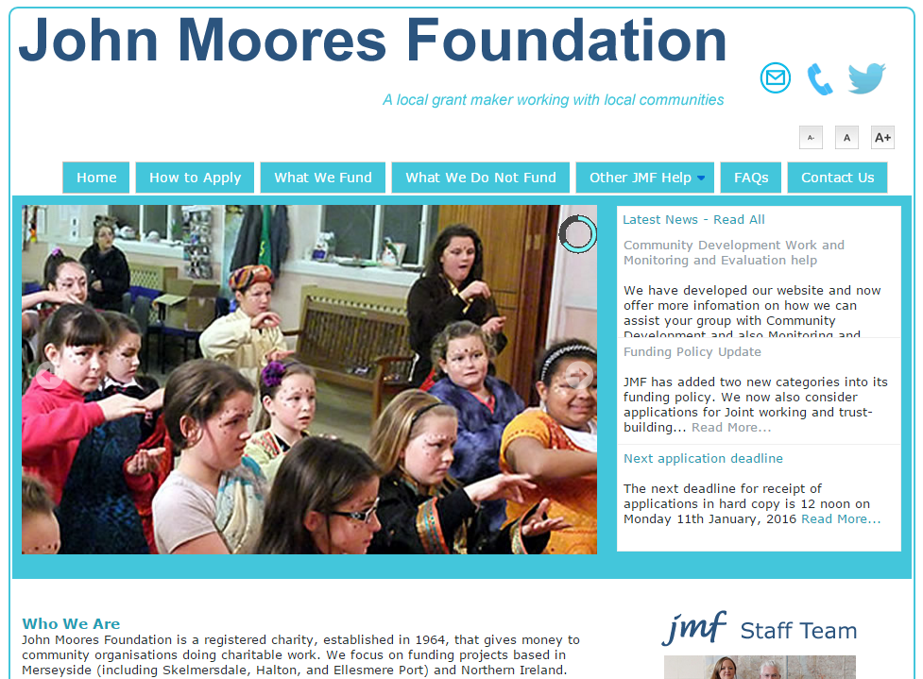
www.jmf.org.uk
Notes:
More information on website

