Slide 1



Gareth Dowling
Chair
West Lancashire Dementia Action Alliance
(Dementia Friendly West Lancashire)

Slide 2
What is Dementia?
The word dementia describes a set of symptoms that may include memory loss and difficulties with thinking, problem-solving or language. These changes are often small to start with, but for someone with dementia they have become severe enough to affect daily life. A person with dementia may also experience changes in their mood or behaviour

Slide 3
What is Dementia?
Dementia is caused when the brain is damaged by diseases, such as Alzheimer's disease or a series of strokes. Alzheimer's disease is the most common cause of dementia but not all dementia is due to Alzheimer's. The specific symptoms that someone with dementia experiences will depend on the parts of the brain that are damaged and the disease that is causing the dementia

Slide 4

Most common types
Alzheimer’s
Disease
Dementia with Lewy bodies
Dementia
Fronto-temporal Dementia
Vascular Dementia
Mixed
Dementia
In total there are in excess of 100 different types of dementia
Alcohol Related Dementia

Slide 5
Who is affected?
Dementia is a disease of the brain which can affect memory, everyday tasks, communication and perception. It is not a result of the normal ageing process.
There are over 850,000 people living with dementia in the UK and this figure is set to rise. 225,000 people develop dementia every year, that’s roughly one person every three minutes. (Alzheimer’s Society 2014)
One in fourteen people over the age of 65 are living with Dementia

Slide 6
Dementia in West Lancashire
Dementia Prevalence across the West Lancashire CCG area is 1.4%, or 1,564
For those over 65 this is a total of 1,483

Slide 7
Already in West Lancashire
West Lancashire
Clinical Commissioning Group
Dementia Working Group
Focus on clinical elements and referral pathways
CCG, Alzheimer’s Society, Age UK, LCFT, Home Instead

Slide 8
Already in West Lancashire
West Lancashire Care Forum
Led by Athena Healthcare Group
(who run Abbey Wood Lodge in Ormskirk)
Focus on ‘Friendship Days’ and running inclusive events for residents, and open to members of public, with or without a diagnosis

Slide 9
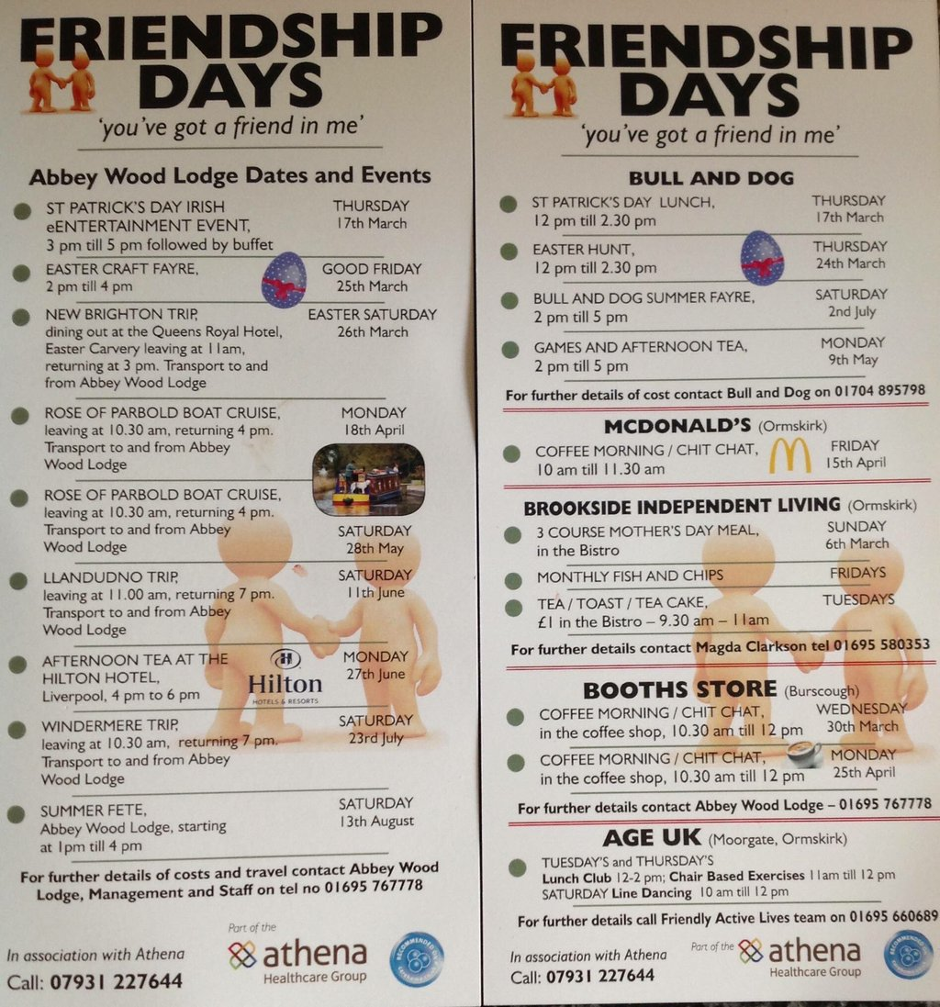
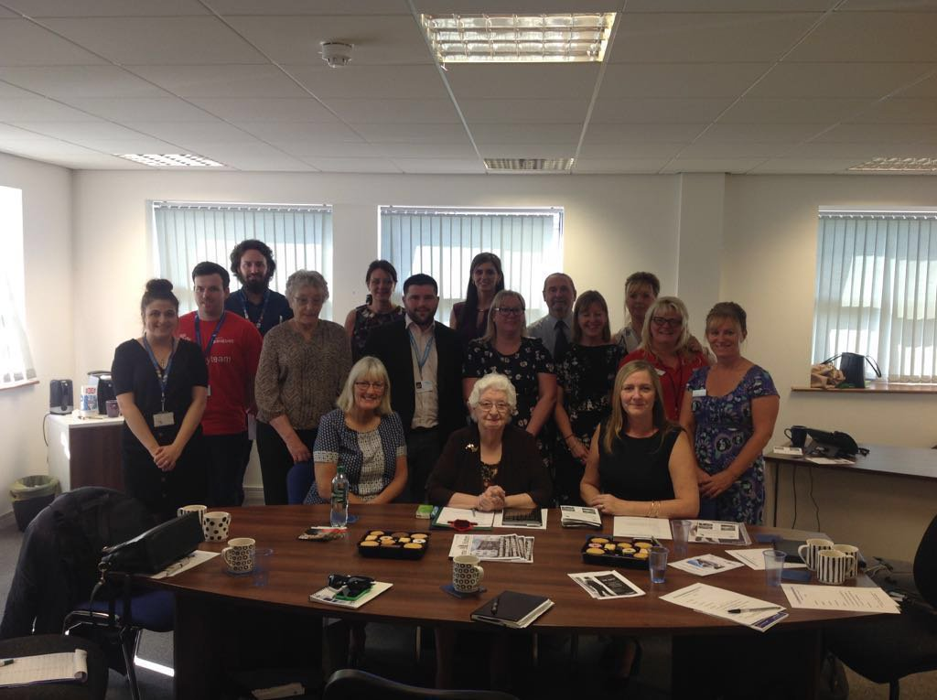
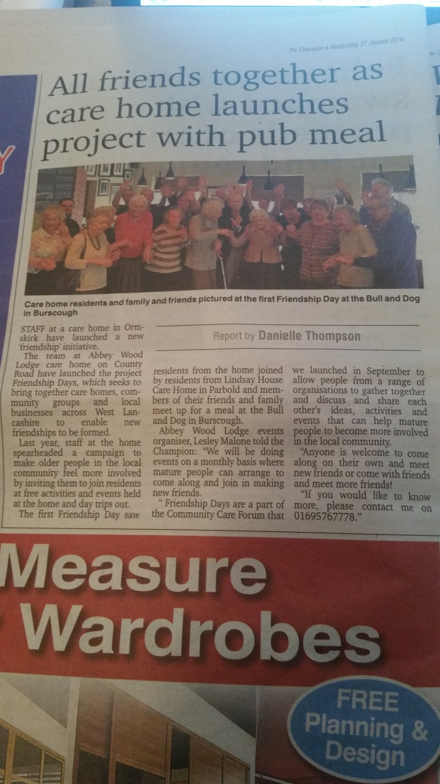

Slide 10
Already in West Lancashire
West Lancashire Ageing Well Forum
Chaired by Dr Alex McMinn MBE, strand of Lancashire County Council Health and Wellbeing Board
CVS, Age UK, Alzheimer’s Society, Home Instead, Borough and County Councillors, U3A, Carers Support, Wellbeing Service, and others

Slide 11
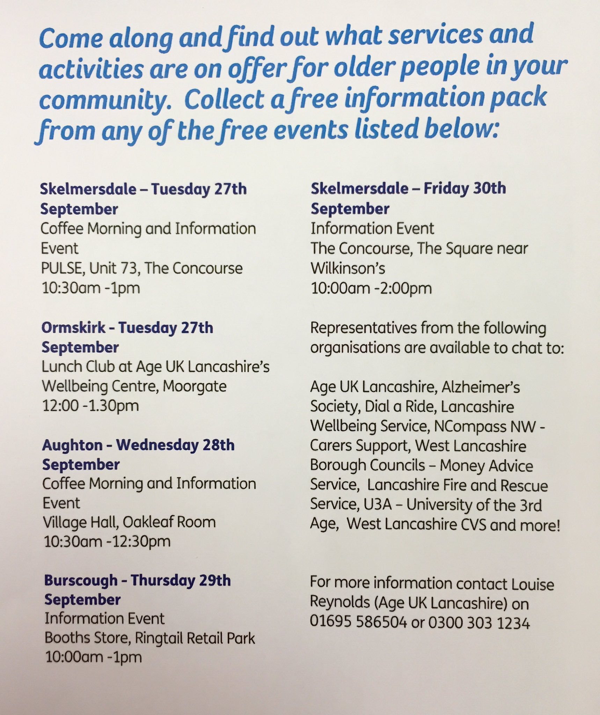
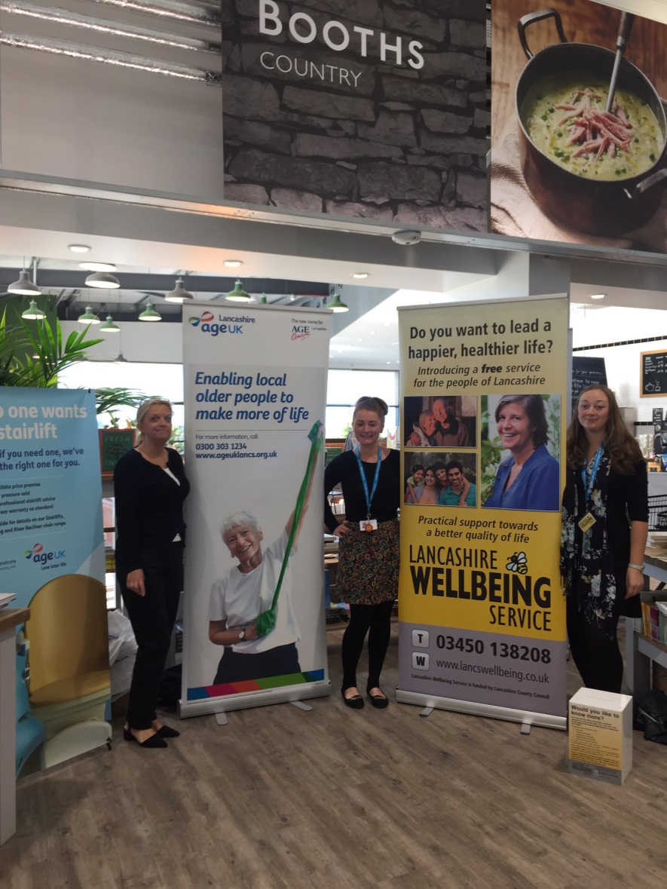
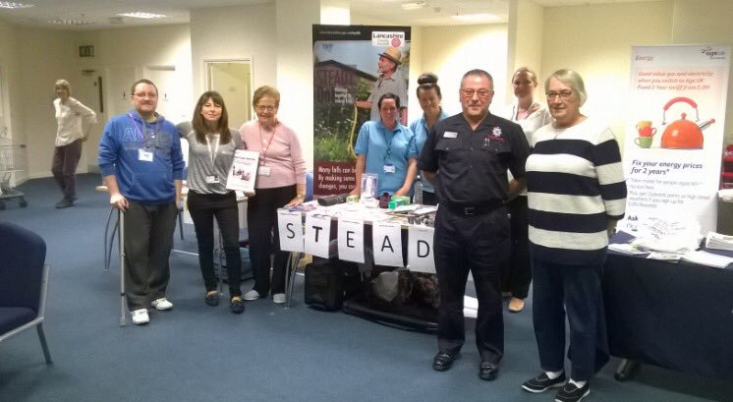

Slide 12
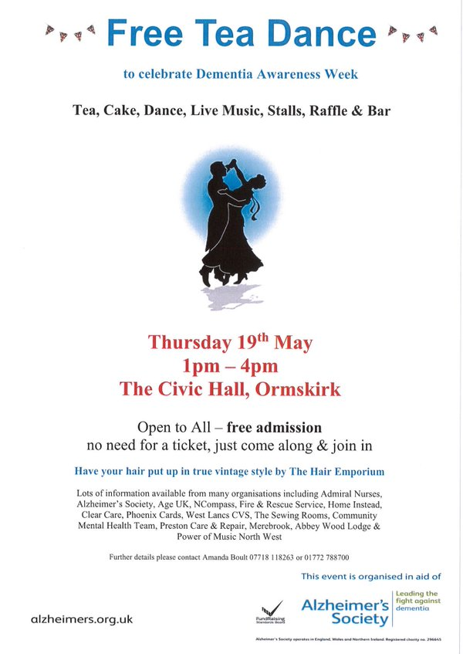
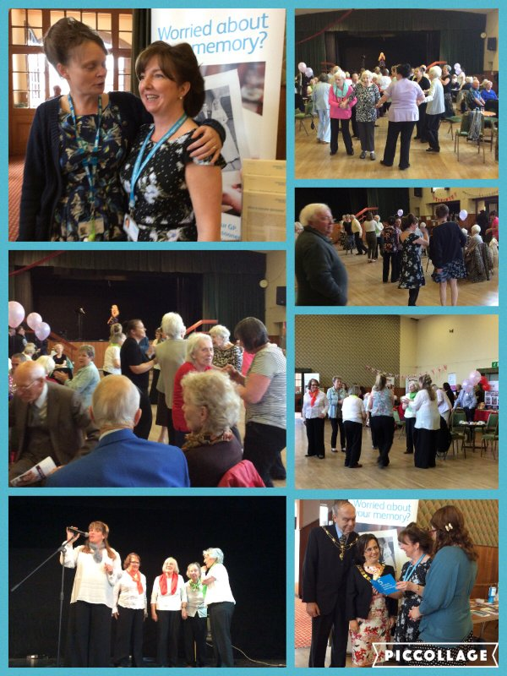

Slide 13
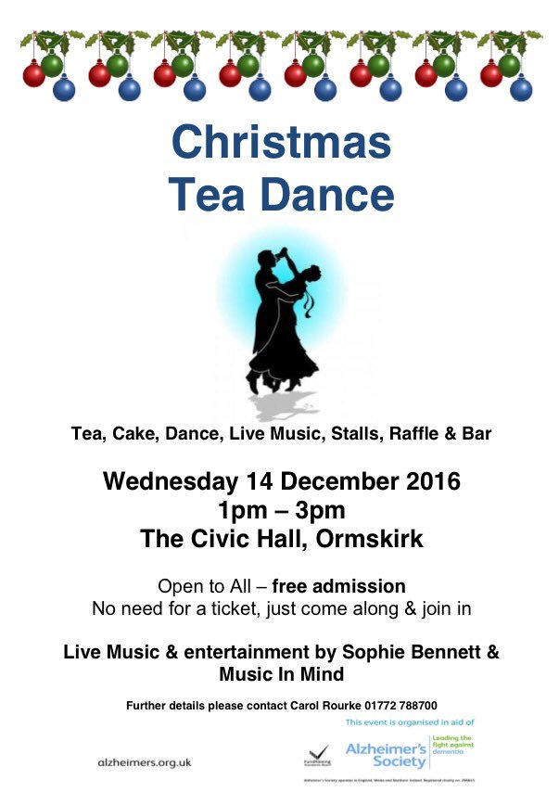

Slide 14
Dementia Friends
in West Lancashire
Dementia Friends is about giving more people an understanding of dementia and the small things that could make a difference to people living in their community
 | L39, L40, WN8 | L31/L33/L37/L39/L40, WN5/WN6/WN8, PR4/PR7/PR8
Dementia Friends | 1,365 | 5,965
Dementia Friends Champions | 32 | 147
Sessions held | 121 | 450

Slide 15
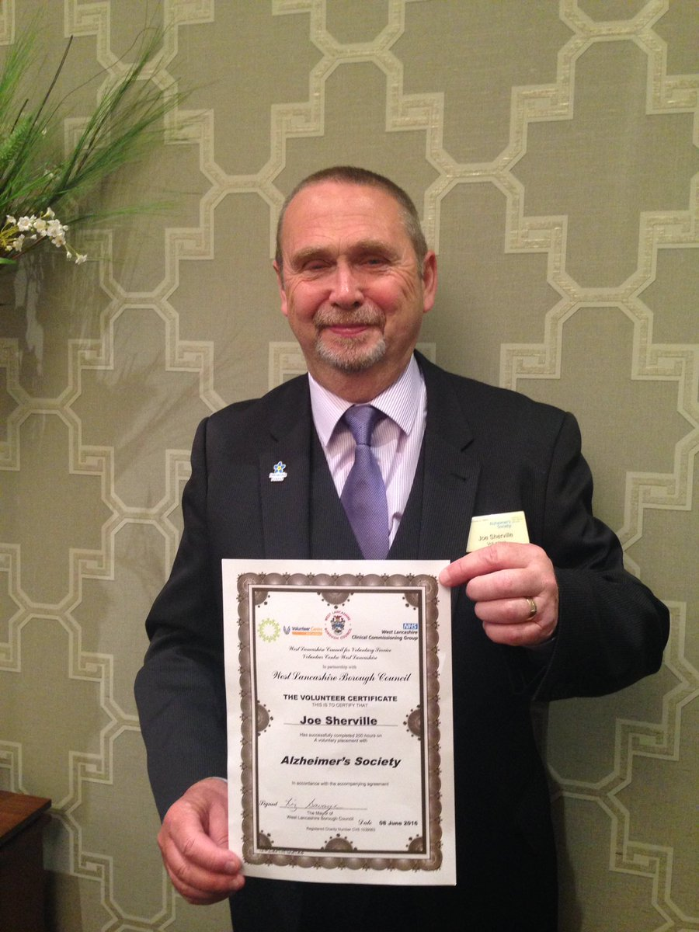

Slide 16
Dementia Action Alliance
A definition:
A Local Dementia Action Alliance brings together regional and local members to improve the lives of people with dementia in their area. They are seen as the local vehicle to develop dementia friendly communities

Slide 17
Dementia Action Alliance
National Dementia Action Alliance
Part of the Prime Minister’s Challenge on Dementia
Over 275 Local DAAs
10 of 14 boroughs in Lancashire
Plus Lancashire DAA
5 of 6 boroughs in Merseyside
Plus Merseyside DAA

Slide 18
Dementia Friendly Community
A definition:
A city, town or village where people with dementia are understood, respected and supported, and confident they can contribute to community life. In a dementia-friendly community people will be aware of and understand dementia, and people with dementia will feel included and involved, and have choice and control over their day-to-day lives. Alzheimer’s Society

Slide 19
So who is involved?
Independent Chair person ? CCG
LCC (Public Health) GP representative
PPG / Patients Association representation People living with dementia
Domestic Carers Professional Carers
Education Borough Council
BAME representation Interfaith representation
Over 50s group representation Alzheimer’s Society
Age UK Emergency Services
Legal sector representation Business / Commercial
Care Home representation CVS

Slide 20
So what does it do?
Raising Awareness
Projects
Learning
and understanding

Slide 21
So what does it do?
Burnley DAA – working with Burnley FC to become first Dementia Friendly Premier League Football Club
Lancaster & Morecambe DAA – working with local college to build dementia directory website, with signposting to all available local services and support
Dementia Friendly Rossendale – working with Lancashire Constabulary on rollout of Dementia Buddies/Guardian Angels scheme
Fylde & Wyre DAA – launching ‘Poulton Pilot’ to get all businesses in Poulton signed up to DAA and become more Dementia Friendly. Lessons learned will be used to make whole of Fylde and Wyre Dementia Friendly

Slide 22
So what does it do?
Pendle DAA – concentrating on large scale awareness events in its three townships with speakers, stalls, and 100+ in attendance
St Helens DAA – secured Dementia Friends Information Session as a criteria of taxi licensing renewal
Liverpool DAA – working on delivering a ‘Design for Dementia’ conference, aimed at architects, house builders and town/council planning departments
Blackpool DAA – working with Blackpool Council and Blackpool Transport, all tram and bus staff are now Dementia Friends

Slide 23
Potential areas of focus:
People Living With Dementia
Retail engagement
Transport
Care agencies networking
Carers Forum
Awareness-raising

Slide 24
Delivery Model 1
Steering Group (Sector reps)
Community Engagement | Business Engagement
Service User Engagement | Volunteering and resources

Slide 25
Delivery Model 2

Slide 26
Delivery Model 3 (Interim)

Slide 27
Delivery Model 4
Buses
Super-
markets
Taxis
Transport
Leisure
Trains
Steering Group (Chair and sub-group leads)

Slide 28
Officer roles
Chair – a figurehead to lead the direction of the alliance, setting up meetings and workstreams as appropriate
Secretary – work with the Chair to run the DAA, with admin support and advice and guidance from Dementia Action Alliance
Treasurer – be responsible for arranging of any bank account setup and managing any potential fundraising income
Admin support – Dementia Friendly Communities Officer (North West) will continue to support the DAA in all its activity, particularly through advice, guidance and sharing of best practice

Slide 29
Terms of Reference
Adopting a Terms of Reference and constituting as a formal group
Volunteers to develop TOR based on neighbouring templates
Essential in case of bank account setup and fundraising

Slide 30
Join the Alliance
Online and paper versions available
Commit to a minimum of three actions as an organisation
http://www.dementiaaction.org.uk/join_the_alliance/get_involved
http://www.dementiaaction.org.uk/local_alliances/17867_west_lancashire_dementia_action_alliance

Slide 31
WLDAA Action Plan
Produce a joint action plan for the wider DAA
Clear commitments and targets for time period ranging 6 months to 3 years
Amalgamation of all individual organisations’ action plans

Slide 32
Thank you for your time
Any questions?

Slide 33
Gareth Dowling
Dementia Action Alliance
www.DementiaAction.org.uk
DFWestLancs@gmail.com
07595 953 099
@GarethDowling @DFWestLancs

