Slide 1
Jen Burns Project Manager
Caroline Flynn
Macmillan Cancer Information & Support Service Manager

Slide 2
Survivorship Programme
E-Holistic Needs Assessment
Treatment Summaries
Cancer Care reviews
Transforming colorectal & prostate cancer follow up
Practice Nurse Education programme
Ward Cancer Champion Education
Macmillan Cancer Information & Support Service

Slide 3
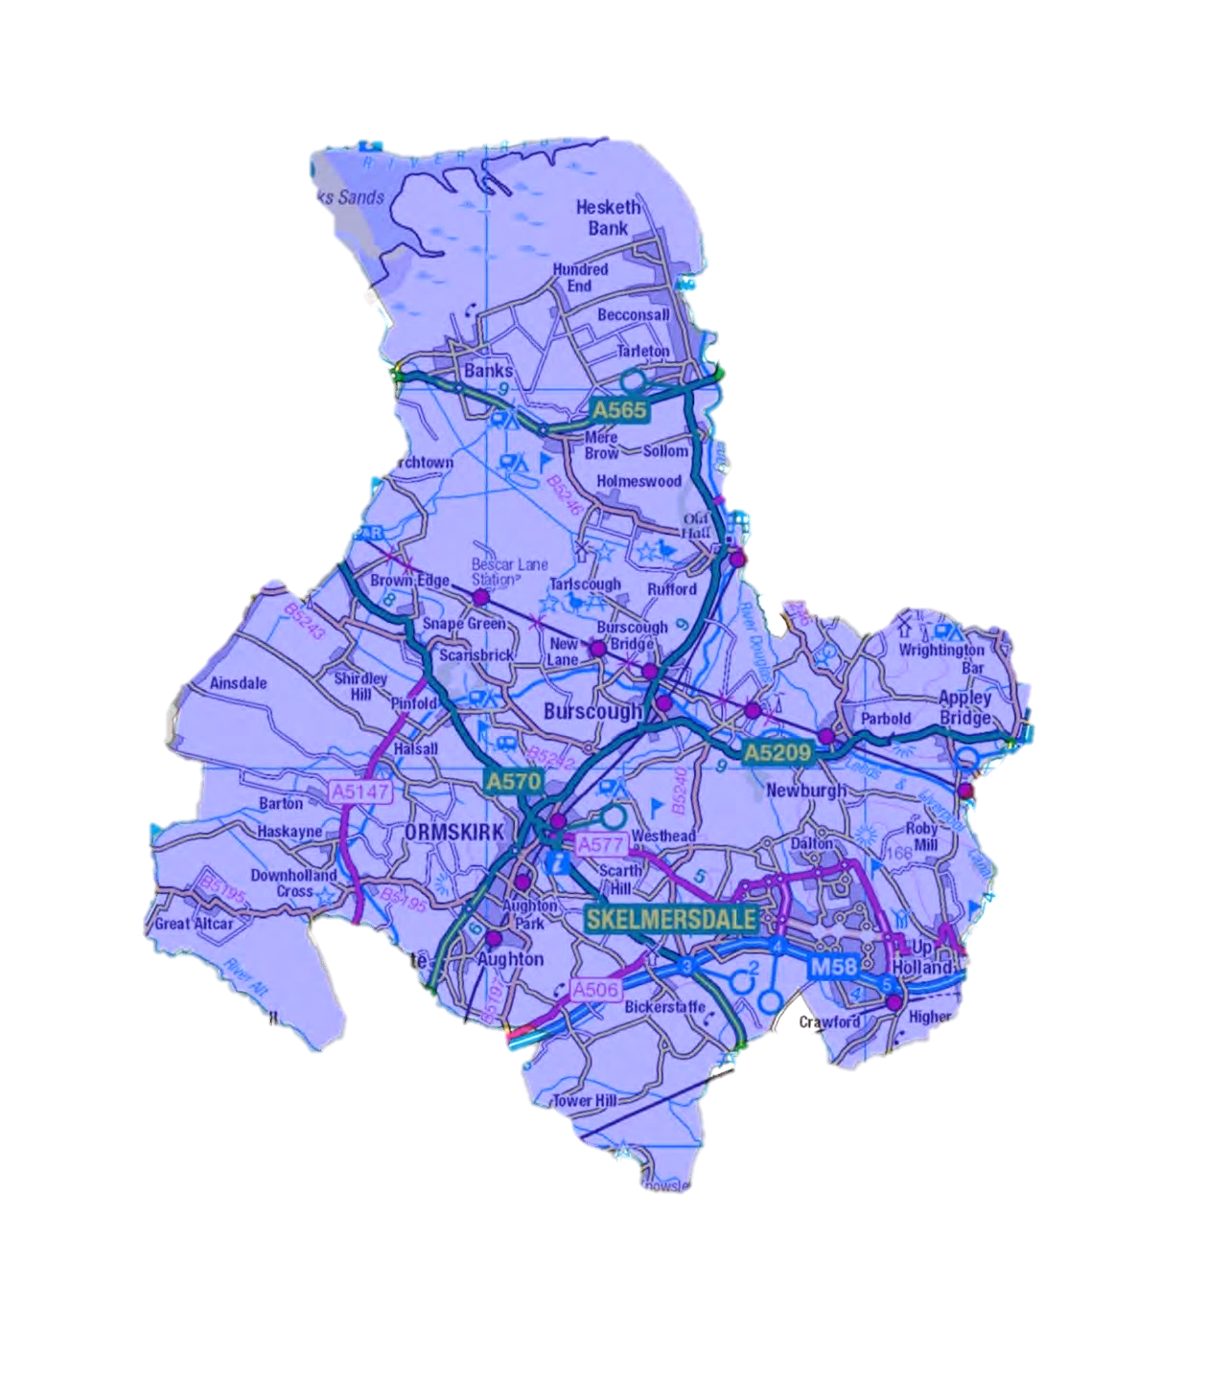
Banks- awaiting agreement for a monthly drop in service
North Meols Medical Centre
Tarleton Library
Information Point
Tarleton Health Centre
Awaiting agreement for a monthly drop in service
Parbold Surgery
Monthly drop in service-
1st Wednesday month
Ormskirk Library
Information Point
Skelmersdale Centre to open May 2017
Mon-Fri 1-5pm
Ormskirk Hospital Information points main corridor
Display boards- Outpatients & all adult wards
Skelmersdale PULSE
Information Point
Working with HR department of a large manufacturing organisation

Slide 4
What will the service look like?

Slide 5
We can support anyone who
requires information about reducing their risks of cancer
has a cancer diagnosis
living with the consequences of cancer treatment
living with and beyond cancer
are a carer, relative or friend
health or social care professionals
business organisations who want to support their employees

Slide 6
Patient, carer, relative
Health Promotion
Early Detection
Cancer Information
Cancer Support
Internet Access
Listening Ear
Signposting-work, travel, financial advice, counselling
Health & Wellbeing Event 30th May

Slide 7
Further Information
Jennifer.burns1@nhs.net
Caroline.flynn4@nhs.net

