Slide 1
The NHS in West Lancashire
Tuesday 25 April 2017
Paul Kingan, Chief Finance Officer and Deputy Chief Officer

Slide 2
112,000 population
19 GP practices
Three neighbourhoods:
Ormskirk and Aughton
Skelmersdale
Burscough and Northern parishes
£163m Funding allocation
£1,455 per person

Slide 3
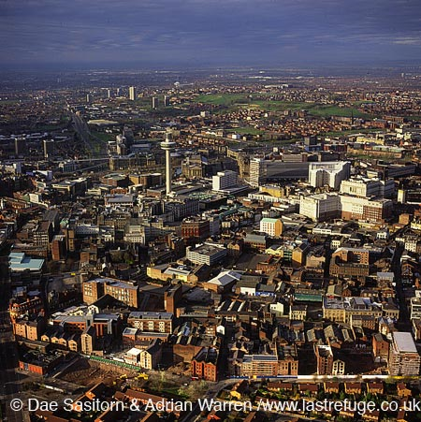
Merseyside from a West Lancs perspective
Acute patient flows are largely towards Merseyside (Southport Hospital) - but also Greater Manchester (Wigan)
Urgent Care Board (A&E and Emergency Care) is North Mersey
Cancer and end of life care
Maternity and children’s vanguard

Slide 4
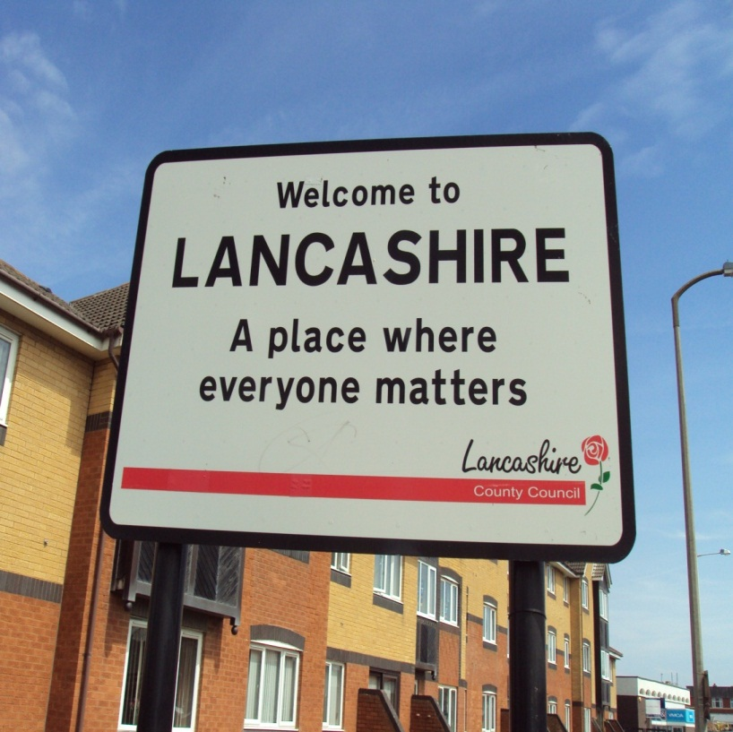
Lancashire from a West Lancs perspective
County and district councils
Public health and social care
Third sector network
Mental health, largely in Lancashire
GPs in Lancashire
Regulated care sector in Lancashire
Out of Hours GP and Walk in Centres
Ormskirk site in Lancashire
Edge Hill University

Slide 5
Healthier Lancashire & South Cumbria

Slide 6
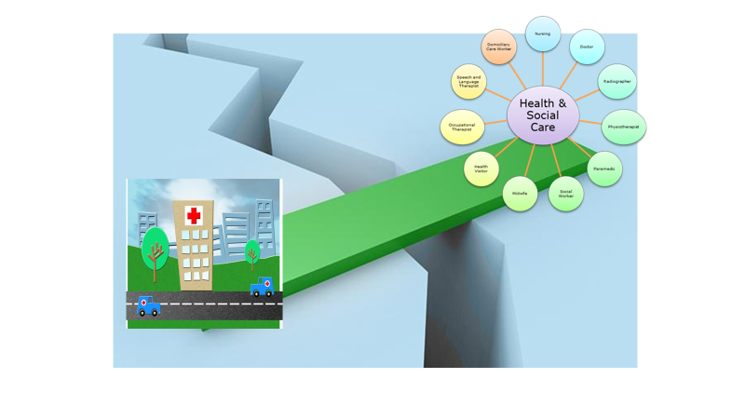
West Lancs working across and influencing both areas
Lancashire Health and Social Care work
Hospital work in Merseyside

Slide 7
Our key focus is the Out of Hospital strategy
“Health is a state of complete physical, mental and social well-being, and not merely the absence of disease or infirmity”
World Health Organisation 1948

Slide 8
Features :
Integrated Services
Neighbourhood teams
Single point of Access
Wider determinants of ill health
Prevention and social prescribing
Early years health
Health, Social care and multi-agency
Strong third sector involvement
Wellness as well as ill health
Community resilience and asset utilisation
Mental health parity with physical health
Targeting hotspot areas and health inequalities Risk Stratification
Flexible workforce
Maximising use of technology
Catalysts:
New Community provider -
Well Skelmersdale
GP Federation
LDP Strategy
Community Services Transformation
Out of Hospital Strategy “Building the future Together”
Primary Care Transformation
Health inequalities including Well Skelmersdale

Slide 9
Some highlights 2017/18

Slide 10
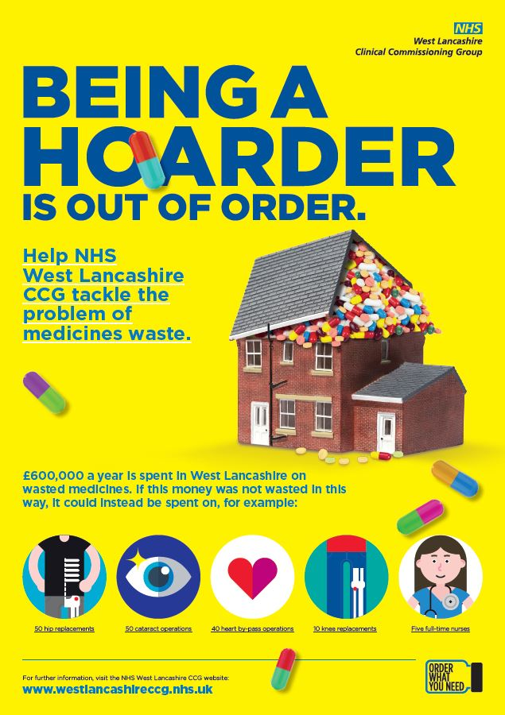
Reducing medicine waste
Spend £600,000 on medicine waste
Launched campaign Being a Hoarder Is Out Of Order in November 2016
GPs now receive repeat prescription requests from patients and carers’
Notes:
Medicine waste
We launched a new medicine waste initiative in November 2016, which looks at increasing safety around medicine use and reducing waste. We spend locally a significant £600,000 on medicine waste. This is medicine that is not needed so ends up being wasted. Our campaign ‘being a hoarder is out of order’ tries to highlight this issue of waste with our community, explaining that this money could support you in various other ways. The main change we have introduced is that the majority of local GP practices will now accept repeat prescriptions orders from patients and/or carers directly and not via a community pharmacist. For those patients who are more vulnerable and have special circumstances, arrangements will be made to further support them with their medicine use.
It is still early days but the initial data looks promising. The December 2016 prescribing figures have shown a £189K reduction in cost compared to December 2015. We also saw a reduction in the number of items being dispensed, increased use of our online portal Patient Access which allows patients to order their prescriptions online, view their medical records and book GP appointments. And Electronic Prescribing System (EPS) is increasing - we are third in the country at 66% - this is when a prescription is sent from a GP practice system to a community pharmacy electronically. This minimises delays for patients waiting for prescriptions and allows for a smoother process in which prescriptions can be generated and edited efficiently. We have more assurance of the quality and safety of the prescribing systems, for example, more accurate medication records and safer prescribing systems, encouraging self-care, more time for pharmacists to carry out medicine use reviews. We would like to take this opportunity to thank our primary care colleagues and patients and carers for their support. We cannot tackle an issue at this scale without everyone’s input and it has been encouraging to see a joined up approach to reducing medicine waste. Further examples of our medicine optimisation work are included in this report.

Slide 11
Reducing medicine waste… the progress so far
December figures show £189K reduction in cost compared to 2015
Seven per cent reduction in the number of items dispensed (minimising the waste)
Users of Patient Access have increased by 75 per cent
Electronic Prescribing System (EPS) is increasing and we are third in the country at 66 per cent
Notes:
EXPLAIN DEFINITIONS
Patient Access is an online portal which allows patients to order their prescriptions online, view their medical records and book GP appointments
EPS is when a prescription is sent from a GP practice system to a community pharmacy electronically. This minimises delays for patients waiting for prescriptions and allows for a smoother process in which prescriptions can be generated and edited efficiently.

Slide 12
Reducing medicine waste
Tackling medicine waste cannot be done alone, patients and carers play a massive part in this so…
Thank you
All BEING A HOARDER IS OUT OF ORDER materials are available on our NHS West Lancashire CCG market stall, with a campaign refresh planned to launch over the coming months.
If you are a group who would benefit from some more copies of these materials, please order some today by speaking to Marco at the market stall
Notes:
Talk about importance of self care and everyone – GPs, patients, carers, pharmacists all working together to tackle medicine waste.
Need to thank the community for playing their part so far. Urge everyone to ensure they only order what you need.
Mention materials available on CCG stand

Slide 13
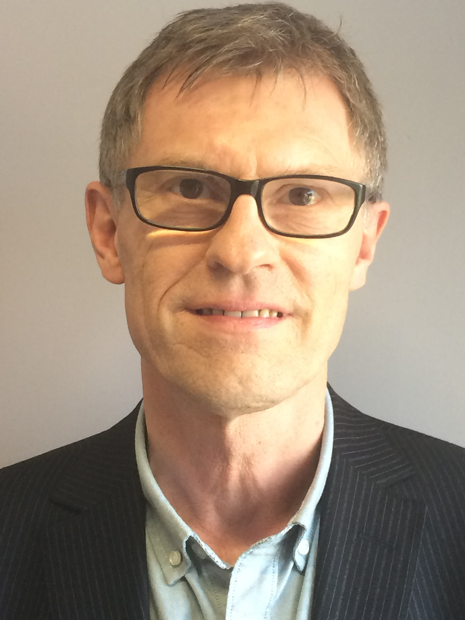
Primary care co-commissioning
The CCG has moved to level three primary care co-commissioning.
This means the CCG has now more control over how funding is spent in primary care
New primary care committee formed. GPs have no voting rights to avoid conflicts of interest
New lay member, Steve Gross
Notes:
Primary care co-commissioning
The CCG has now been granted level 3 co-commissioning, which means we take over the commissioning of local GP practices from NHS England as of 1 April 2017. This has full support of the CCG’s membership of GP practices and will bring West Lancashire CCG in line with other CCGs in Lancashire and many others across the country. To avoid any conflict of interest, a new delegated primary care committee has been established, which no local GPs cannot vote on. At the end of the financial year, we also welcome a new lay member, Steve Gross, to focus on primary care who will be crucial to this area of work.

Slide 14
Extended hours
The CCG has extended hours so local residents have better access to GPs
Thursday and Friday evenings from 6.30pm – 8pm at the West Lancashire Health Centre (Ormskirk)
Saturdays from 10am – 4pm and Sundays from 10am to 2pm at the Sandy Lane Health Centre (Skelmersdale)
To make an appointment to see an extended hours GP, contact your own GP practice
Notes:
Extended hours
We introduced extended hours in November 2016. This new pilot is a result of NHS England’s General Practice Forward View, which is a national guide for primary care services over the next five years. Within the guide, it states that GP access in England is to be improved to provide greater GP access to the population at evenings and weekends within the next five years. Local residents can now (accurate as of Spring 2017) see a GP on Thursday and Friday evenings from 6.30pm – 8pm at West Lancashire Health Centre in Ormskirk; on Saturdays from 10am – 4pm and Sundays from 10am to 2pm at the Sandy Lane Health Centre in Skelmersdale. Patients can make an appointment to see an extended hours GP, simply by contacting their normal GP surgery. The extended hours continue to be highlighted within our ongoing Examine Your Options campaign which highlights what health services are available to patients and how they access them.

Slide 15
Patient Participation Groups (PPGs)
Every GP practice has a PPG
January 2017, the CCG welcomed practice managers/PPG members to attend the first West Lancashire wide PPG meeting, with the second meeting taking place last week
Chaired by patients, with attendance from Healthwatch and the CCG
Sign up to your own PPG, by speaking to your own GP practice
Sign up to West Lancashire wide PPG by contacting the CCG
Notes:
There was no joined up West Lancashire forum for these PPGs to work together. Now there is!
CCG will chair initial meetings and then patient group will run itself and manage own agenda items
Thank you to Hall Green Surgery PPG who has been fundamental to this work
Patient Participation Group (PPG)
We were approached by a proactive Patient Participation Group (PPG) in our area with a request to help them work across the county with other patient groups associated with GP practices. At the time, there was no vehicle to do this. We saw an opportunity to create a clear link between the practices PPGs. We invited every GP practice to nominate a practice member of staff and member of their PPG to attend a meeting to discuss how these groups could work together. In January 2017 the group came together for their first meeting, with further ones scheduled for later in the year. The group will be run by the patients, with attendance from Healthwatch and the CCG. Lay member for patient and public involvement, Greg Mitten, has offered to chair the initial meetings until the group agrees its own arrangements. This group will not only help by sharing learning with each other, it will also encourage further participation in their own practice and the wider NHS across the health economy.

Slide 16
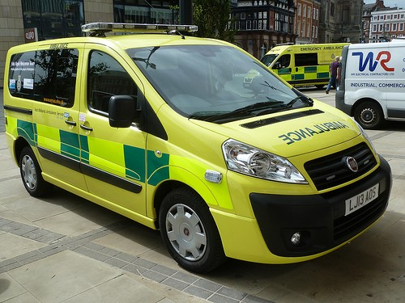
Falls car
Launched six month pilot with North West Ambulance Service, running until June 2017
The car responds to ambulance calls if a person has fallen
Avoids unnecessary visits to A&E
62 per cent of people seen by the Falls Car stay at home
Notes:
There is a Paramedic and Occupational Therapist on the Car who can assess the faller and complete falls assessments and provide equipment to help keep people at home.
The aim of the Car is to avoid unnecessary journeys to A&E and aims to provide assessments and support at home instead.
The Pilot has been running for 2 months and results show that 62% of people stayed at home, compared with 40% before the pilot started.
Falls car
This year, to help ease winter pressures, we started running a falls car pilot in partnership with NWAS (North West Ambulance Service) and Southport and Ormskirk Hospital NHS Trust. This car is staffed by a paramedic and occupational therapist and has specialist lifting equipment. The car responds quickly to patients that have fallen and provides assessment of future falls risk, equipment and referral to other services at the scene, as appropriate. Similar cars being used in other areas of Lancashire have allowed patients to stay at home and have prevented admissions to hospital for patients with no significant injuries.

Slide 17
Community health services and urgent care services
Carried out a procurement process for local community health services and urgent care services
Selected preferred provider Virgin Care, who will start delivering the service from 1 May 2017
Services will still be provided as part of the NHS and FREE at point of contact
Health Overview and Scrutiny Committee and NHS England remain assured of process followed
Notes:
Please note - we have spoken to third sector at CVS events about this many times so it shouldn’t be new to the audience
The CCG’s vision for joined up care, known as Building for the Future, aims to help everyone - especially the older population and those living with long-term conditions - be in more control of their own health, have better access to health services and receive co-ordinated support tailored to their own personal needs.
This process is about transforming care locally and is a major positive step forward for West Lancashire. The aim is to develop and enhance community and local walk-in and out of hour’s services, helping to prevent avoidable acute hospital attendance, relieving pressure on such a vital resource. We will continue to enable and support the local hospital to do what it does best, in addressing the needs of those residents who need acute and specialist care. Our local hospital will continue to be a major part of local health services and will remain integral as we move towards achieving our vision for joined up care.
National procurement legislation requires CCGs to enable all NHS and independent sectors providers to compete. Only those bidders that are successful following evaluation against set criteria can proceed to the next stage of the process. All bidders are treated fairly and transparently to ensure we secure the best provider possible for the benefit of our patients.
Staff will be TUPE’d across on existing NHS terms and conditions

Slide 18
Selected by Well North; a movement to “unleash communities across the North of England”
Skelmersdale was chosen to be one of the ten pathfinder sites
Run by local people but led by the CCG
Identified themes and agreed our ambition
Set up a ‘mug club’
Get in touch! hello@wellskelmersdale.org

Slide 19
Respiratory events
Free events held in community
Help those living with respiratory conditions and those interested in good lung health
With British Lung Foundation (BLF), Southport and Ormskirk Hospital NHS Trust and the Breathe Easy Group West Lancashire
Notes:
Respiratory events run as part of our ongoing work on this area of priority

Slide 20
Chronic pain
Many people living with chronic pain in West Lancashire
Currently seen in primary care and hospitals but often have a broader need e.g. physical activity, nutrition and psychological
Clinicians highlighting risk of patients becoming dependent on medication
CCG recognises a specialist chronic pain service is needed
Welcomed views December 2016 – February 2017. Currently reviewing next steps
Notes:
By ‘chronic pain’, we mean a pain that persists beyond the point at which healing would be expected (3-6 months) (read more via British Pain Society 2007).
Likely to go out and test the market – our thoughts on chronic pain are available via our CCG stand today
Chronic pain
In West Lancashire, there are several people living with chronic pain day in day out. Chronic pain means a pain that persist beyond the point at which healing would be expected (three to six months). These people are having to see their GP or visit hospital for treatment and pain relief medication. They need to do this as we currently have no specialist pain service. This year, the CCG identified the need to improve these services which would serve the patients’ broader needs for example physical activity, nutrition and psychological needs. Between December 2016 and February 2017, we invited views from the community about their experiences of living with chronic pain, and accessing professional advice and treatment for chronic pain locally. The views were overwhelmingly supportive of the need for something more specialist to cater for their needs. In March 2017, we published a Chronic Pain: the story so far document which captures our current thoughts. In 2017/18, the CCG hopes to progress on this work and improve chronic pain services in West Lancashire.

Slide 21
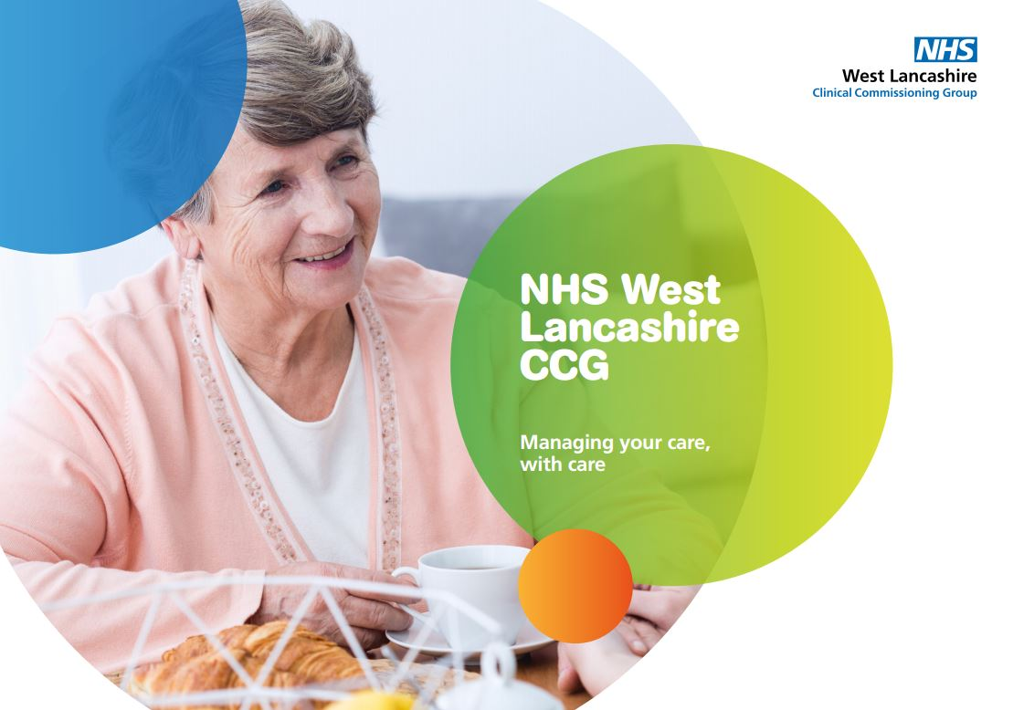
Financial recovery plan
Continue to face financial challenge
Developed a public summary of our financial recovery plan
Shows many ways we hope to be more efficient
Available from the CCG market stall today
Notes:
Our financial challenges
As any other CCG in the country, we know we need to work differently to make the most of the limited resources we have. In March 2017, we published a public summary of our financial recovery plan to bring to light the kinds of efficiencies we are trying to make. The summary document called Managing Your Care, With Care is available on our website and on request. It is important that all members of our local community understand the challenges as they play a massive part in us working differently. For example, in the case of medicine waste, our community has shown great support so far in terms of reducing the medicine waste and only ordering the medicine what they need. This needs to continue to truly tackle this issue. In terms of service choice, we also continue to urge our local population to assess the options of health services available to them. This is reinforced through our Examine Your Options campaign which aims to highlight the range of options available nearby and therefore reduce pressures on services such as A&E.

Slide 22
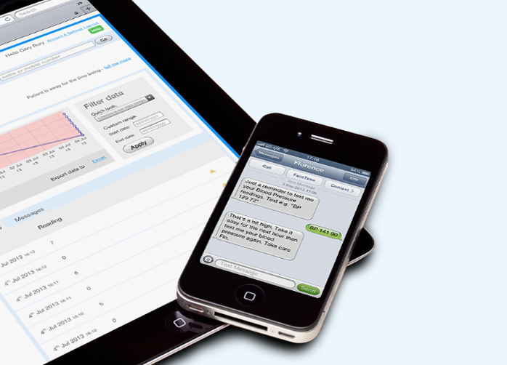
FLO
Telehealth system named after Florence Nightingale
Patients send in readings such as their weight, blood pressure, pulse and oxygen saturation levels from their own mobile phone
Monitored by heart failure specialists
Keeps patients out of hospital and helps them manage their own condition at home
Notes:
Talk about this is one of many examples within digital health work – crucial to our future and working more efficiently
Texting with FLO
Working with Liverpool Community Health and Southport and Ormskirk Hospital NHS Trust, we launched a pilot Telehealth System called FLO, which helps patients manager their long term health conditions by texting their weight and blood pressure, for example, from their own mobile phones. These shared readings are then monitored by the specialist heart failure team and the local community matrons and are responded to depending on the patient’s needs. This is a great innovative example of our digital health work and also ties in with what we are hearing from patients in terms of wanting to be more involved in their own care and also having the knowledge to manage their conditions. FLO is already proving to be a major support for patients in the area, with many receiving immediate intervention (sometimes remotely allowing clinicians to work more efficiently) based on their recorded readings. The FLO pilot initially supported patients with heart failure but it will soon extend to patients living with respiratory conditions, including Asthma and Chronic Obstructive Pulmonary Disease (COPD).

Slide 23
Rally Round is a FREE online service that helps people
Can add day to day tasks to the ‘to do list’ around an individual’s personal needs
Text or email notifications allow everyone to stay in the loop
www.rallyroundme.com/wlcvs
Notes:
Rally Round is up and running.
Allows carers, family, neighbours etc. to help an individual with their needs whether that is taking them to see their GP, buying food or carrying out some daily tasks at home.
Rally Round means everyone can see what they need to do and when, and allows you to share information on a joint to do list.
If anyone knows of anyone who may benefit from trialling this, please speak tot the CVS or CCG today.

Slide 24
Investment in voluntary, community and faith sector
CCG board has agreed to allocate £100,000 (recurrently) for the local voluntary, community and faith sector
This is in recognition of the value this sector plays
Details of next steps are still being worked up
Notes:
I’d like to conclude this presentation on a very good note. In West Lancs, we are blessed with an active voluntary community and faith sector. This is something we have recognised since day one and continue to do so.
This year, we have allocated £100k (TBC??) for this sector as our recognition of its value. The detail of how this will be made available and allocated is still unclear as it was a recent decision by the CCG. However, we will work with CVS to communicate an update when one is available.
Thank you to everyone here today that has continued to work hard within this sector and contributed to the health and wellbeing of the people in West Lancashire, hopefully the year ahead will bring further great collaborative work.

Slide 25
Thank you for listening.
Are there any questions?

